Slide 1


Asset Management Overview
Omaha Public Power District

Slide 2
Asset Management Workshop
Enterprise Level Asset Management Initiative - Overview

Slide 3
What is Enterprise Level Asset Management?
Initiative Charter in a Nut-Shell
  Asset Management is a framework of control, directional alignment, cross-disciplinary collaboration, optimization, and continual improvement.
  The Asset Management team will build the program to align the organization on asset management standards, establish processes and organizational committees to administer the asset management program, as well as enable asset management leadership throughout OPPD.
  The outputs of the team’s deliverables will create an environment where OPPD can be better stewards of our customer-owner’s resources as by being more confident that we are investing in the right assets, at the right times, in the right ways.

Slide 4
Who is on the core team? Who can I contact?
Name | Title | Business Unit
Roger Grable | Lead Asset Management Programs | Energy Production
Randy Veik | Lead Asset Management Programs | Energy Production
Josh Reimers | Senior Engineer Maintenance Optimization | Energy Delivery
David Spargo | Manager of T&D Maintenance Optimization | Energy Delivery
Inna Goldman | Manager BT Performance & Administration | Business Technology / Building Services
Dwayne Hansen | IT Enterprise Architect | Business Technology / Building Services
Scott Buchholz Jr. | Operations & Maintenance Work Crew Leader | Business Technology / Building Services
Sean Frazier | Enterprise Risk Analyst | Corporate Strategy & Governance
TBD | Senior Project Manager - Capital Investment | Financial Services
Tom Virgillito | Senior Project Analyst - Capital Investments | Financial Services
Matt Hurlbert | Project Analyst - Capital Investments | Financial Services

Slide 5
Who else can I contact?
Advisory Committee
Name | Title | Business Unit
Joel Johnston | Director Integrated Work Management | Energy Production
Scott Eidem | Director Engineering Services | Energy Production
Dan Lenihan | Director T&D Planning & Strategy | Energy Delivery
David Boyd | Manager BTBS Support Services | Business Technology / Building Services
Steve Brown | Director Enterprise Architect | Business Technology / Building Services
Jacob Farrell | Manager of Building Services & Operations | Business Technology / Building Services
Mike Donahue | Manager Transportation | Financial Services
Dan Laskowsky | Director Risk Management | Corporate Strategy & Governance
Robert Kaminski | Director of Strategic Planning | Corporate Strategy & Governance
Initiative Oversight
Charter Defined Role | Name
Executive Sponsor | Javier Fernandez
Executive Steering Committee | Javier Fernandez, Kate Brown, Mary Fisher, Troy Via, Scott Focht
Charter Manager | Brad Underwood
Initiative Lead | Brad Seier

Slide 6
When and how will this impact me next?
Strategic Asset Management Plan (SAMP) Development
  In the next few months, we will be drafting the District’s first SAMP.
  SME (all of you and your teams) input will be needed.
Additional Items Throughout 2020
  Lots of work to do in 2020 that will require your input!
  The core working team and/or Advisory Committee will be contacting you as needed for support.
Asset Management Advocacy
  More communications will be coming when we have items to share.
  What information would you like / what would be helpful to you and your teams?

Slide 7
Asset Management Overview
Omaha Public Power District

Slide 8
Introductions
Who you are?
What department are you from?
Each day what to do you set out to accomplish?
(Besides email and attend meetings)
Expectations of the AM session?

Slide 9
Disclaimer
This presentation/workshop/session is not intended to replace or insult what you may already know or being doing regarding “Asset Management”
These are mostly my ideas and thoughts, presented with reference to context found in the Asset Management domain
Please feel free to contribute and improve Asset Management thinking

Slide 10
Day 1 Learning Intention and Objective
Setting context
Challenge your thinking
Building the foundation and applying fundamentals
Notes:
Do we agree with these?

Slide 11
Agenda – Day One (Morning)

Slide 12
Agenda – Day One (Morning)

Slide 13
Agenda – Day One (Afternoon)

Slide 14
Agenda – Day Two (Morning)

Slide 15
Agenda – Day Two (Afternoon)

Slide 16
Insert BP Texas City Video
Notes:
This video was released at a pivotal time in my career. Arguably this changed my view on asset management more than anything prior and anything since. Process Safety Management became a passion of mine as did failure eradication in people, processes, data, and equipment. The whole must be considered not just the individual.

Slide 17
Exercise 1: BP Texas City
With your current thinking about asset management what-
  Strategy(s)
  Role(s)
  Action(s)
  System(s)
- might have made a difference to prevent the incident?
Notes:
The Hollywood movie about Macondo is an excellent way to talk about asset management. Graham says there are 11 barriers which have a hole in them causing this incident. LOPA model where the barriers fail to stop the incident.
Deep Water Horizon
Watch the video again and capture some items in the notes section

Slide 18
Break: 9:20 – 9:30
"The proper management of physical assets
remains the single largest business improvement
opportunity in the 21st century”
H.W. Penrose

Slide 19
What is Asset Management
History
Definition
  Asset Definition
  Management Definition
Current Global Footprint
“A contradiction of terms”
Graham Macleod VP Asset Integrity
Notes:
Let’s be clear everyone is managing assets to some degree; we will discuss this more today and tomorrow.
So this concept isn’t about doing more managing. The concept is about tightening tolerances on the requirement for managing the asset, or in some cases relaxing those tolerance, etc.

Slide 20
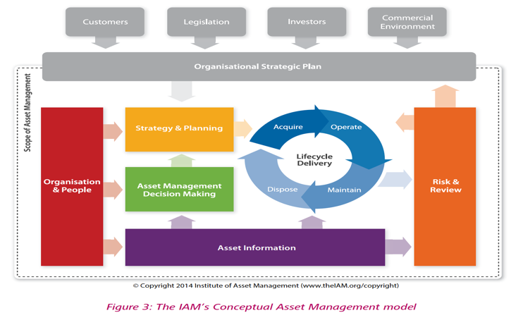
Conceptual Diagram

Slide 21

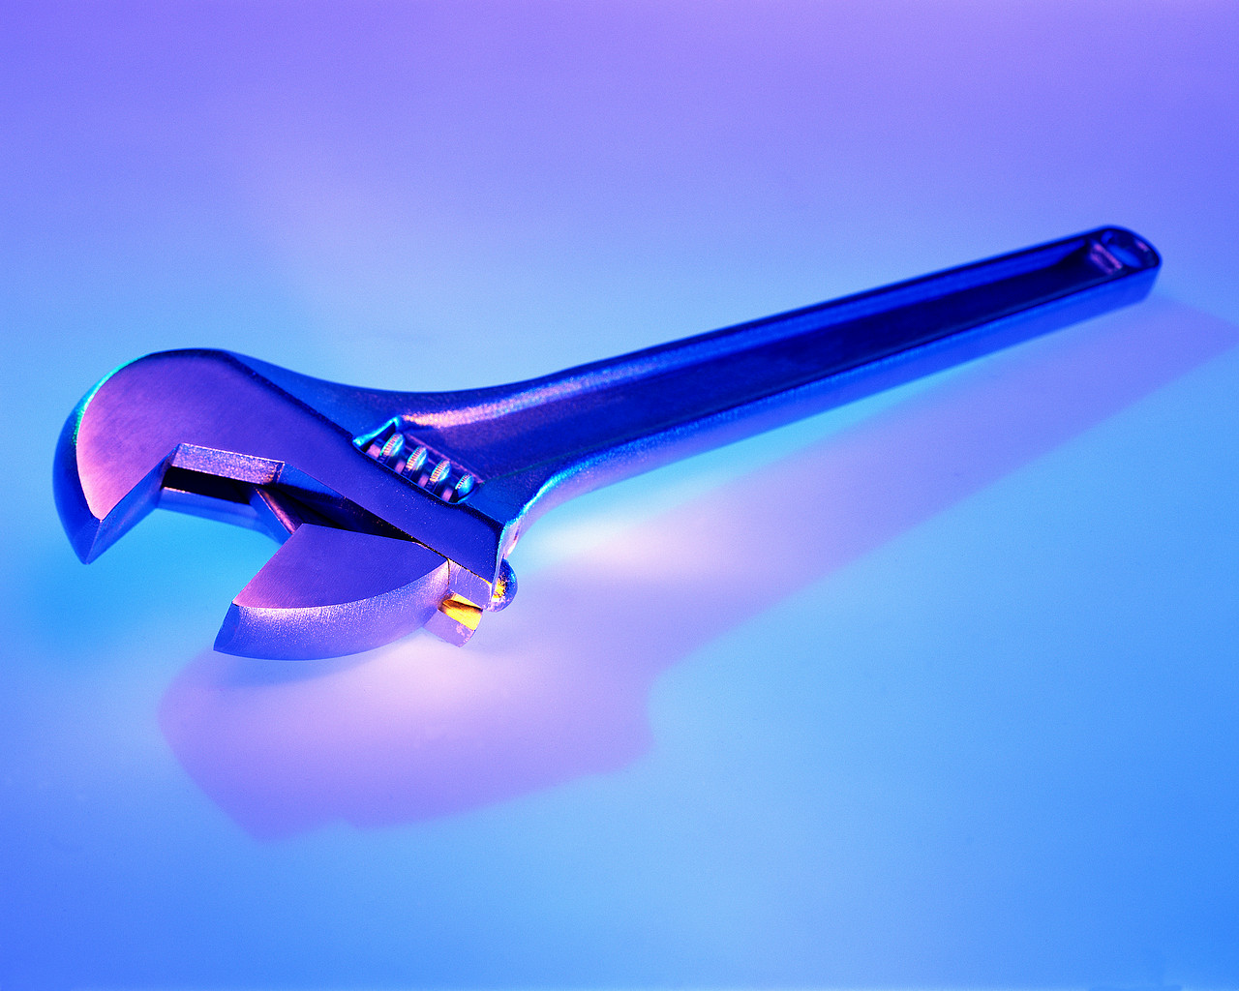


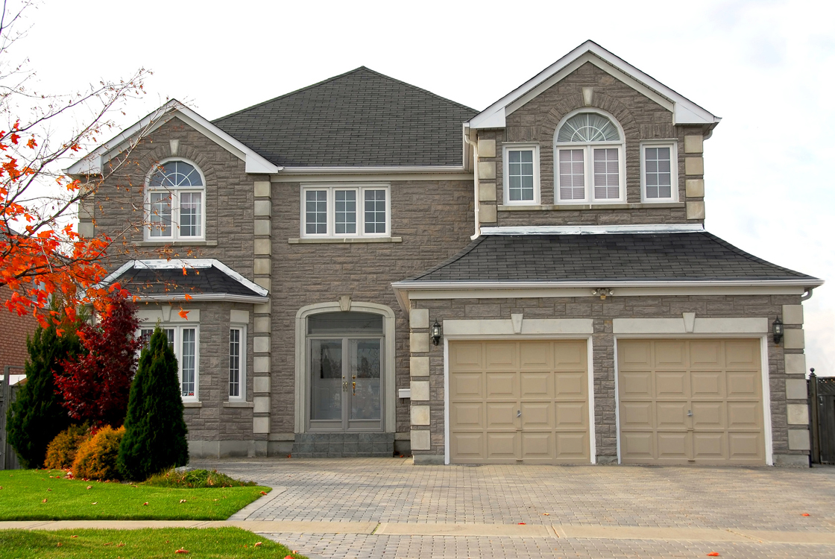
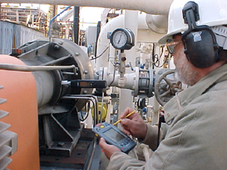
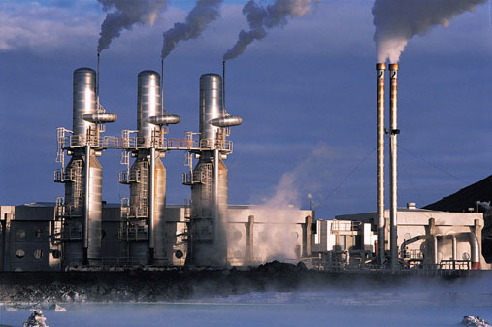
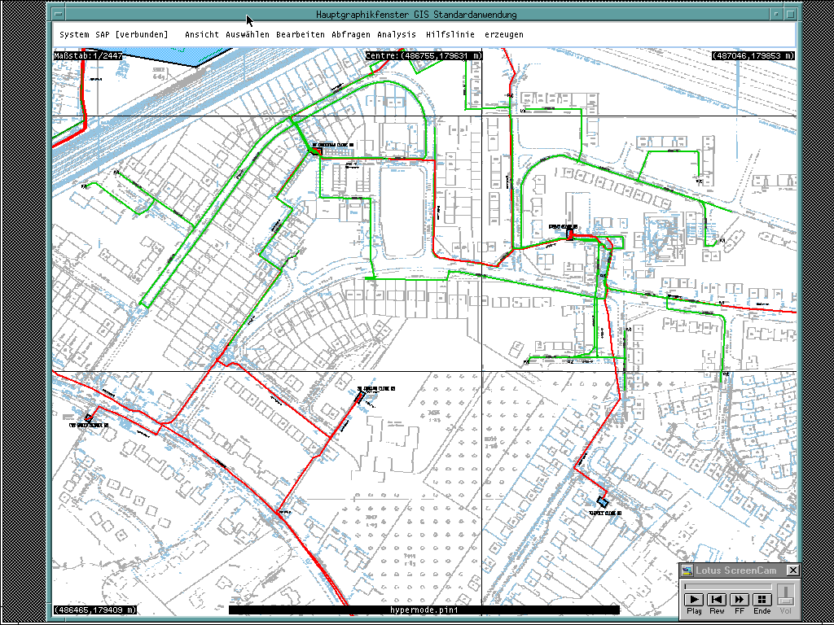




Multiple Views of Managing the Asset
Location
IT
Productive
Maintenance
Customer
Asset Views
Environmental
Competence
Spatial
Logical
Financial
Source: Gartner
OEM
Ownership
Notes:
The many ways to look at an asset include plant, equipment, machines or facilities. Usually this starts and ends with a physical "EAM" classic view. Even if there was awareness of other aspects, historically organizations have been siloed to a point where only one view was important to a department or an operational unit. Separation and disconnect between the views have occurred. To get maximum value from an asset, it is beneficial to see more than one view. This enables balancing the different forces, and pressuring companies to value one perspective over another. Thus, we can balance the values and needs or differing parts of the organization. Also, a complexity and relationship of assets requires more information to make informed decisions. Thus, it is beyond "preferable" to obtain multiple views, it is becoming mandatory. To achieve this, companies must take stock of what is important and relevant to their world (Are you operations-dispersed, mobile or fixed?) and then determine their maturity in managing the data in each category, and the interrelationships between those elements and the whole picture. A 360-degree view of the asset must be the goal of any asset-intensive company.

Slide 22
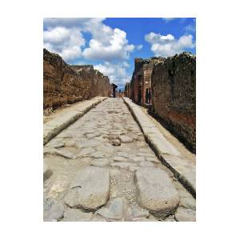
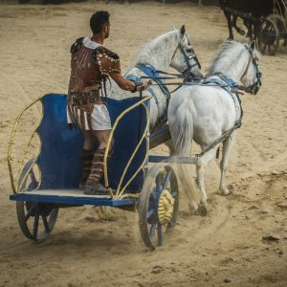

History
The Romans
  Chariots
  Roads
  Infrastructure
The senses
  Sight
  Hearing
  Smell
  Taste
  Intuition
Much of what the Romans did though was lost in the middle ages

Slide 23
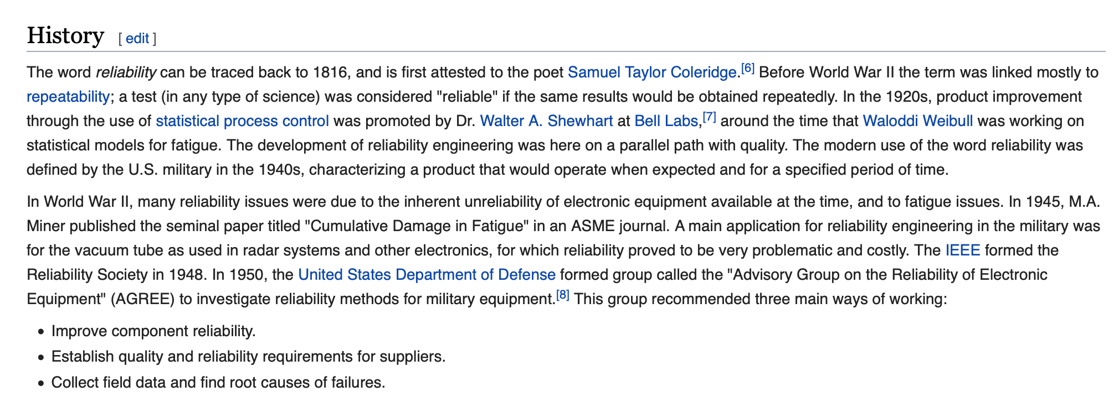
Reliability
https://en.wikipedia.org/wiki/Reliability_engineering
Notes:
To me reliability has the least amount of ambiguousness of the words we are condition to use. (Maintenance, Preventive, Preventative, Asset, Management) Reliability stands along with a strong meaning, one which most people understand and believe in. Everyone wants their people, process, data, and equipment to be reliable!

Slide 24
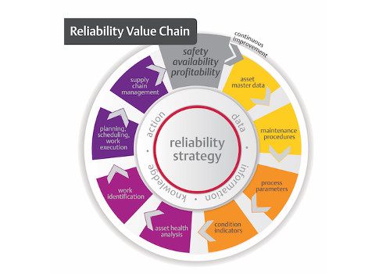
Reliability at the center of the reason behind the history of Asset Management
Reliability as a word in the Asset Management context has the least amount of ambiguousness:
  Maintenance, Preventive, Asset, Management, Failure, Malfunction etc.
Reliability stands alone with a strong meaning, one which most people understand and believe in.
Everyone wants their people, process, data, and equipment to be reliable!
Courteously of Plant Engineering

Slide 25
Asset Management Progression?
First Generation - 1940 – 1955
  Fix it when it broke
  Basic and Routine maintenance
  Corrective maintenance
Second Generation - 1955 – 1975
  Time-based maintenance
  System for planning and controlling work
Third Generation - 1975 – 2000
  Condition based maintenance
  Reliability-centered maintenance
  Computer aided maintenance management and information system
  Workforce multi-skilling and team working
  Proactive and strategic thinking
Current Generation - 2000+
  Risk-based inspection
  Risk-based Maintenance
  Risk-based life assessment
  Reliability-centered maintenance
  Condition based monitoring
  Computer aided maintenance management and information system
https://www.fiixsoftware.com/blog/evolution-maintenance-practice/

Slide 26
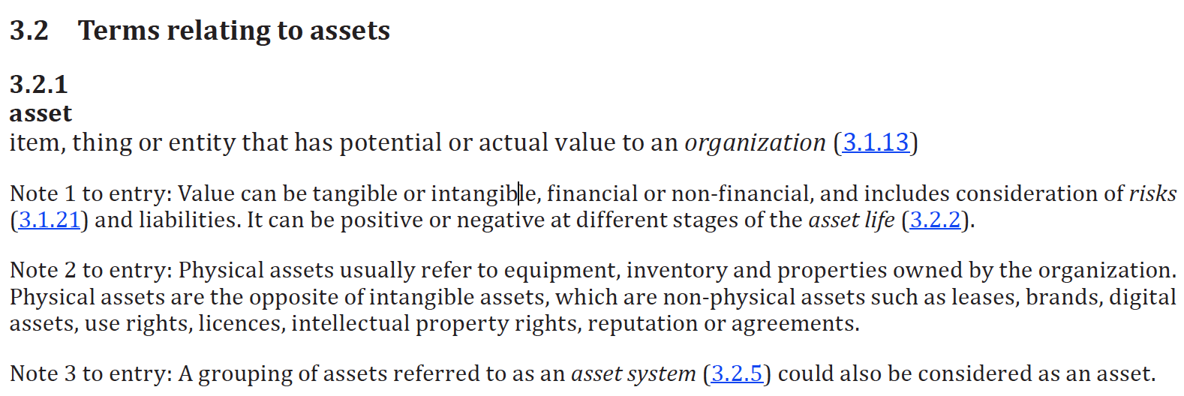
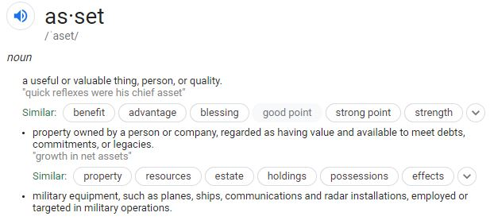
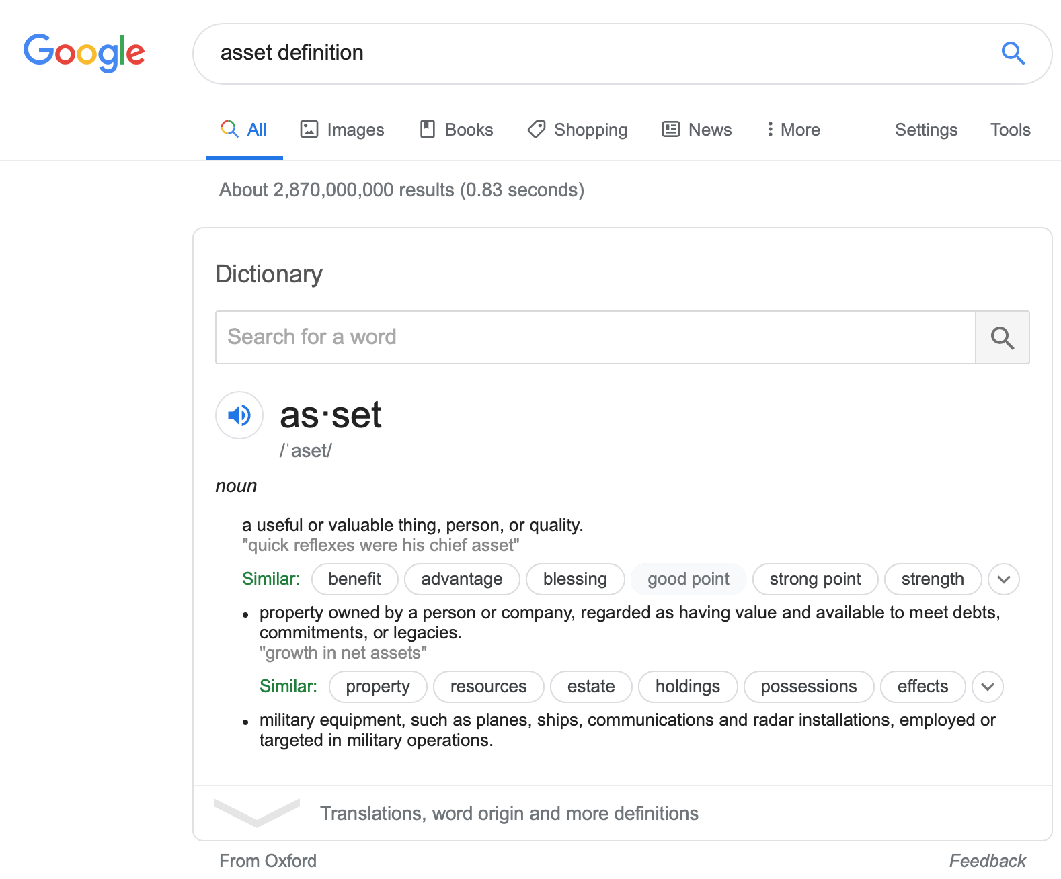
Asset Definition

Slide 27
Management Definition
To manage something means to monitor, measure, report, control, adjust, and repeat. For example:
A thermostat manages the temperature of a room for example. There is a requirement (control) and response from the thermometer to the device (report) if the requirement changes (adjust) etc.
Thus, Asset Management is just that done over and over and over and over to ensure the outcome matches the requirement.
Asset management presents the opportunity to address changing conditions ahead of time and potentially identify conditions before they become failures.
Notes:
This example resonates because it is relatable, we all have exposure to how a thermostat works. We also expect it to work like this. The concept demonstrated can be applied to larger “assets” where this asset was a warm comfortable room being managed through automation. An analog version of this would be a wood stove or fireplace where the human is the sensor and the goosebumps are the report.
What’s an OPPD example of equipment vs a thermostat
Defeated before you begin
Engineering design, materials selection, operating environments, acquisition and divestiture
Operational excellence – past tense
Best practices – past tense
Switch tense get in front of the degradation and the decisions
To start with it’s two independent words jammed together
Each of which have different meanings to the other
What is Asset Management cannot be discussed completely with out the ”Why” which comes up next….

Slide 28
Asset Lifecycle (Typical)
Graph depicts no failures or downtime
All Inspections completed as per scheduled maintenance frequencies.
Full maintenance scope of works completed as per equipment maintenance procedures.
Equipment not run outside of operating limits.
Process hasn’t exceeded equipment thresholds.
Typical Preventive Maintenance Schedule
Major Overhaul
Major Overhaul
Inspection
Inspection
Inspection
Inspection
Inspection
Inspection
Inspection
Inspection
Asset Birthed
Year 1
Year 2
Year 3
Year 4
Year 5
Year 6
Year 7
Year 8
Year 9
Year 10
End of Life
OEM
Warranty
Period
Life Extend or
Dispose/Replace?
Notes:
Every event will impact risk cost and performance
Its to the point where if you talk about the equipment it’s considered an event
Classification though of the event is critical to ensure you can compare events and their individual criticality and their characteristics
The thermostat (nest, ecobee) is becoming perfect at temperature management

Slide 29
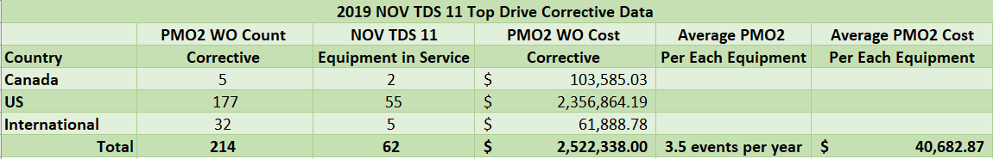
Test Case - 2019 Rotating Mechanical
Average Corrective Costs & Events per year
Major Overhaul
Major Overhaul
Typical Maintenance Schedule
Life Extend
or
Replace?
Inspection
Inspection
Inspection
Inspection
Inspection
Inspection
Inspection
Inspection
Corrective
Repairs
PMO2 x 3
Corrective
Repairs
PMO2 x 3
Corrective
Repairs
PMO2 x 3
Corrective
Repairs
PMO2 x 3
Corrective
Repairs
PMO2 x 3
Corrective
Repairs
PMO2 x 3
Corrective
Repairs
PMO2 x 3
Corrective
Repairs
PMO2 x 3
Preventive $?
+
Corrective $?
+
Downtime Costs $?
+
No of Events #?
=
Total Cost of
Ownership
Corrective
Repairs
PMO2 x 3
Asset in Service
Year 1
Year 2
Year 3
Year 4
Year 5
Year 6
Year 7
Year 8
Year 9
Year 10
End of Life
OEM
Warranty
Period

Slide 30
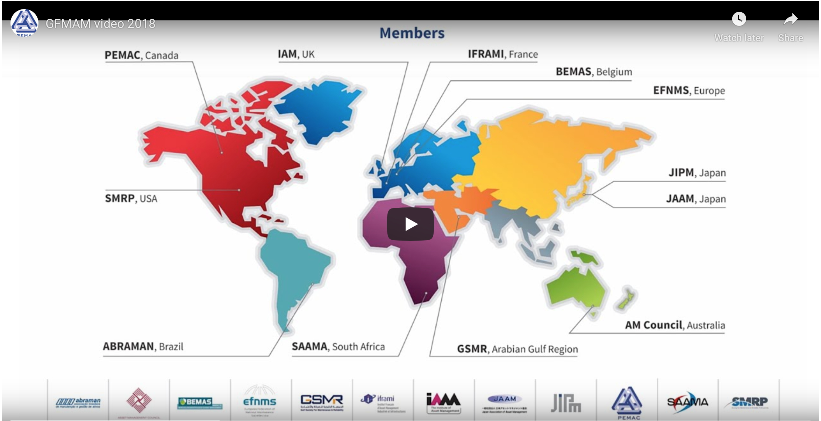
Asset Management Around the World

Slide 31
Transition to the Why
What is Asset Management cannot be discussed completely with out the ”Why” which comes up next….

Slide 32
The “Why” of Asset Management
Paradigms
The target
Personal “Why”

Slide 33
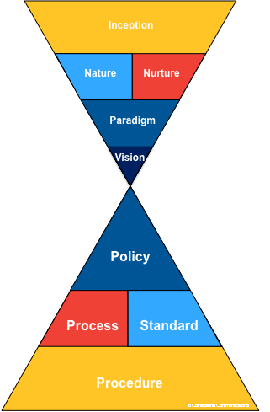

Paradigms (beliefs) form
the Vision
Vision shapes the Policies (Structures)
Structures drive behaviors (processes/standards/procedure)
Behavior yield results.
The collection of behaviors in an organization forms the culture.
If the desire is a different culture the behaviors must change.
If different behaviors are required, the structures (policies, processes, standards, procedures) must reflect the need.
However, most likely current vision and paradigms must be challenged first!
Notes:
Paradigms (beliefs) form the Vision. Vision shape the Policies (Structures) … Structures drive behaviors (processes/standards) … Behaviors yield results. The collection of behaviors in an organization form it’s culture. If want different culture … must change behaviors … if want different behaviors must change structures (policies) …. If want different structures (policies) must change current vision and challenge current paradigms (beliefs).

Slide 34

This is how I grew up – not business casual – but in coveralls
On the farm
Exposed to all the wonders of what it took to keep such an operation running

Slide 35

My first critical mechanical asset

Slide 36
The Why – of Asset Management
Safety
Availability / Reliability
Analysis

Slide 37
The Why – Balanced with:
Cost
Risk
Performance
Notes:
A scenario of where it doesn’t work – Terry Wireman example - ????
Air Force One example
Competing factions – redundant pump example and operations desires

Slide 38
Start with the Why! Simon Sinek Video

Slide 39
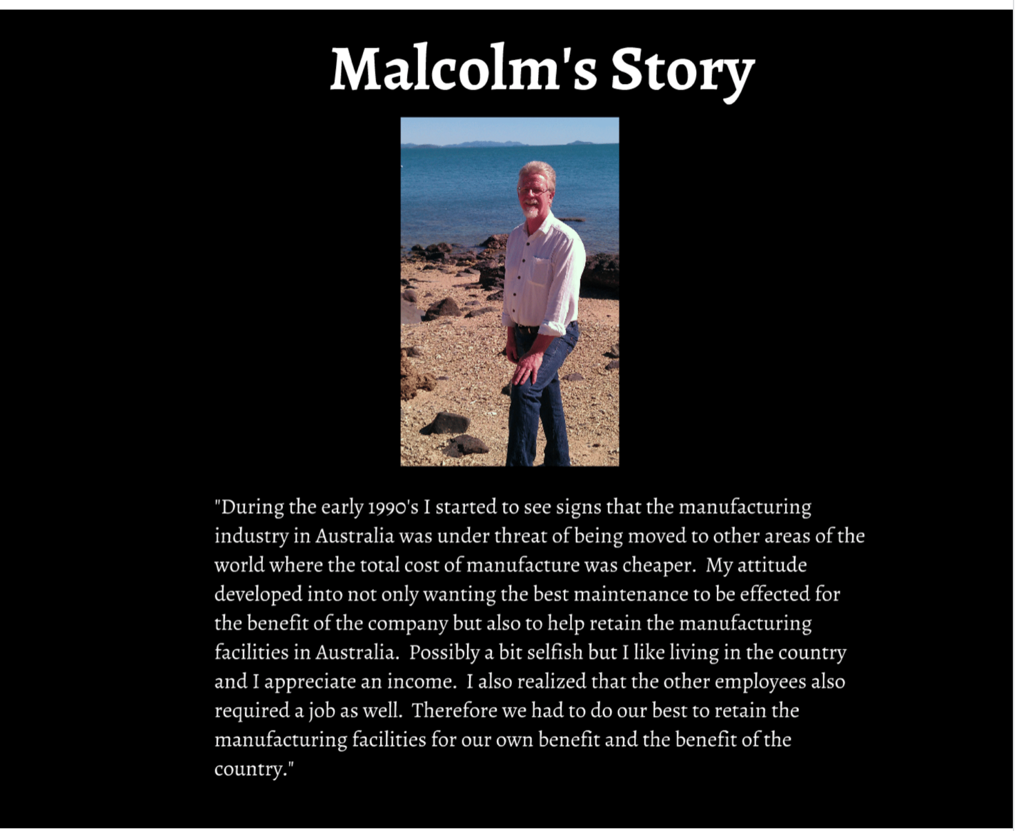
A very personal story

Slide 40
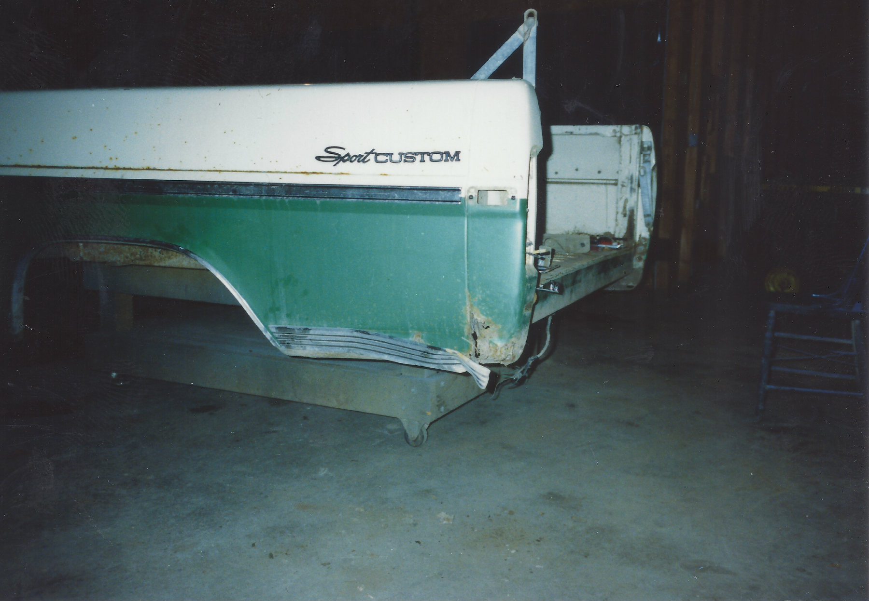
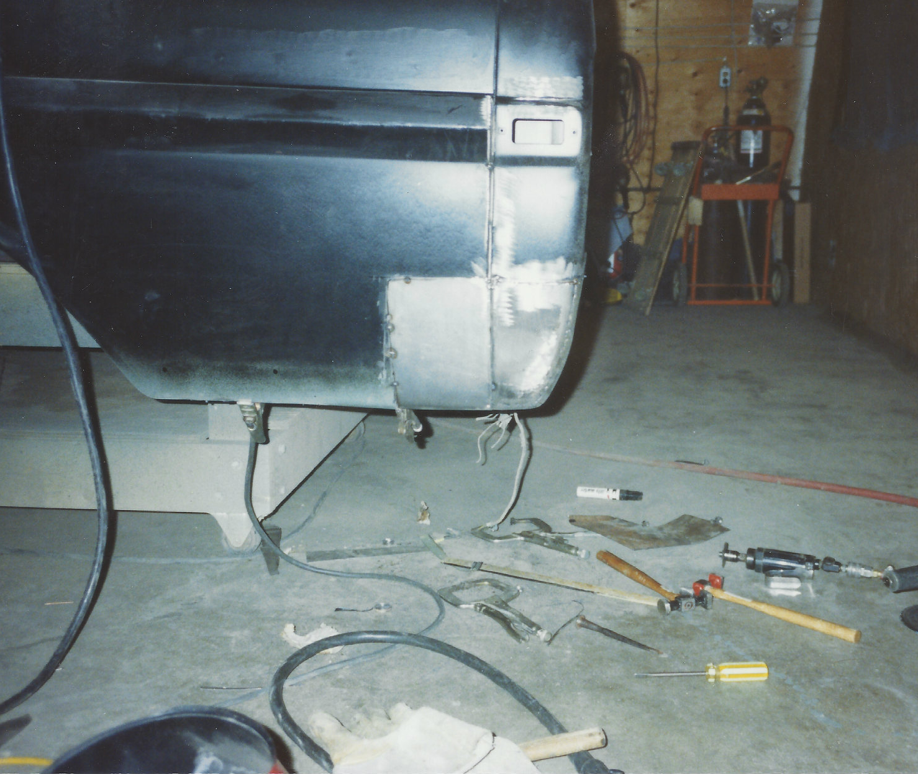
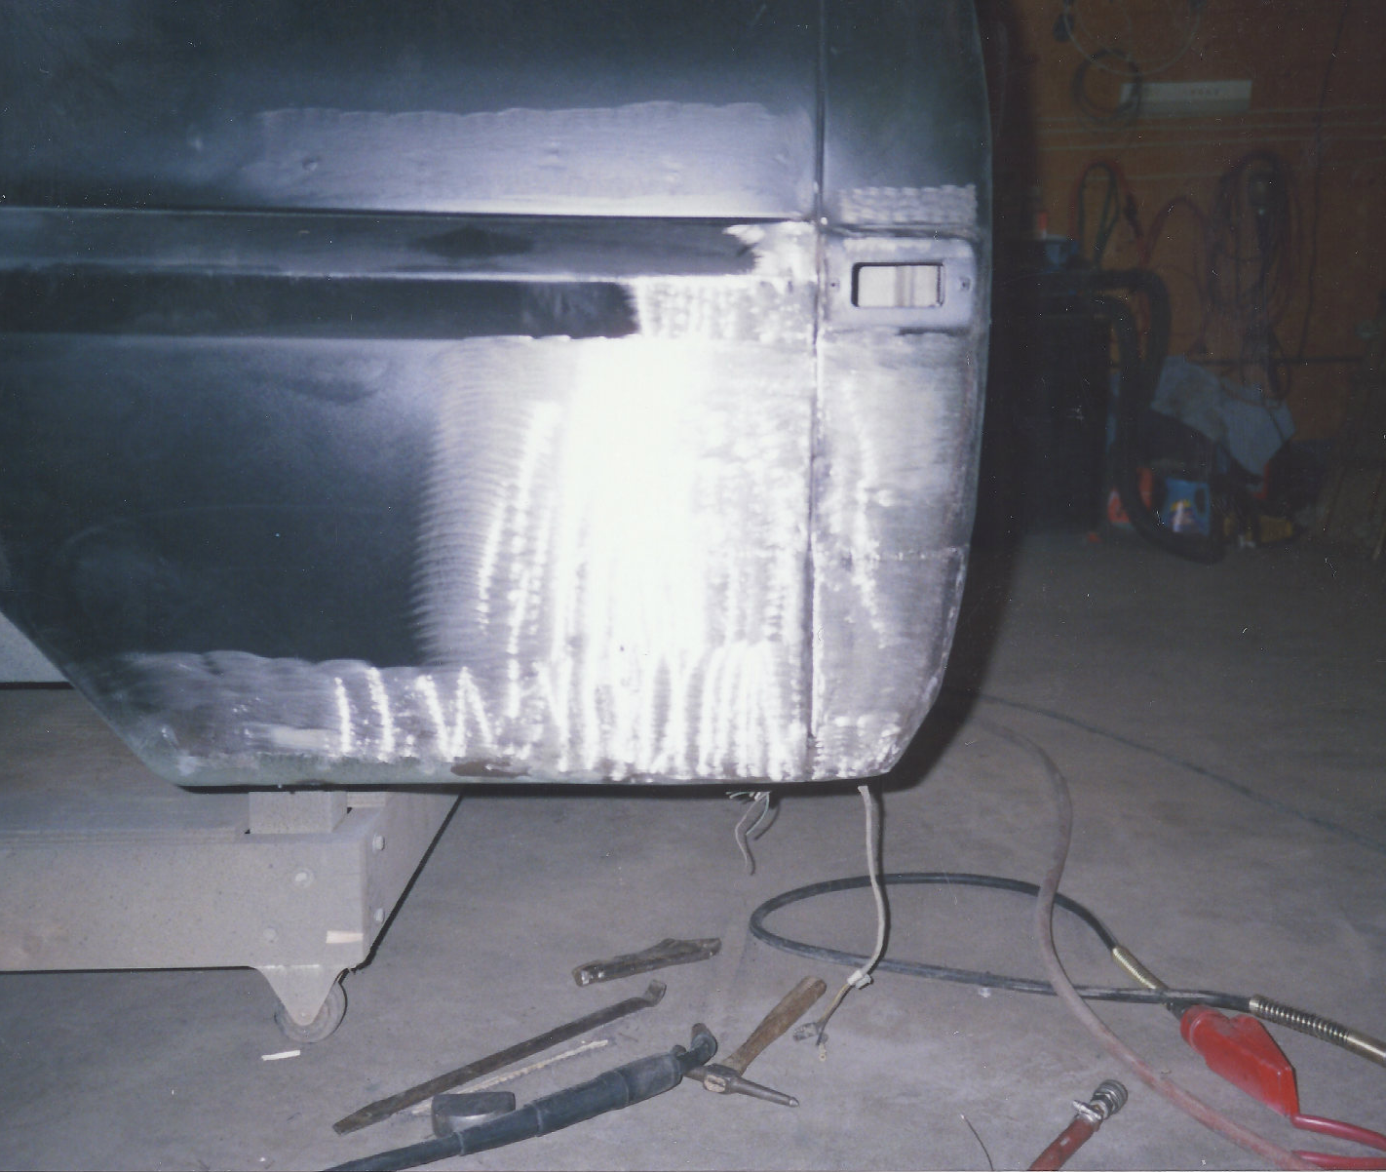
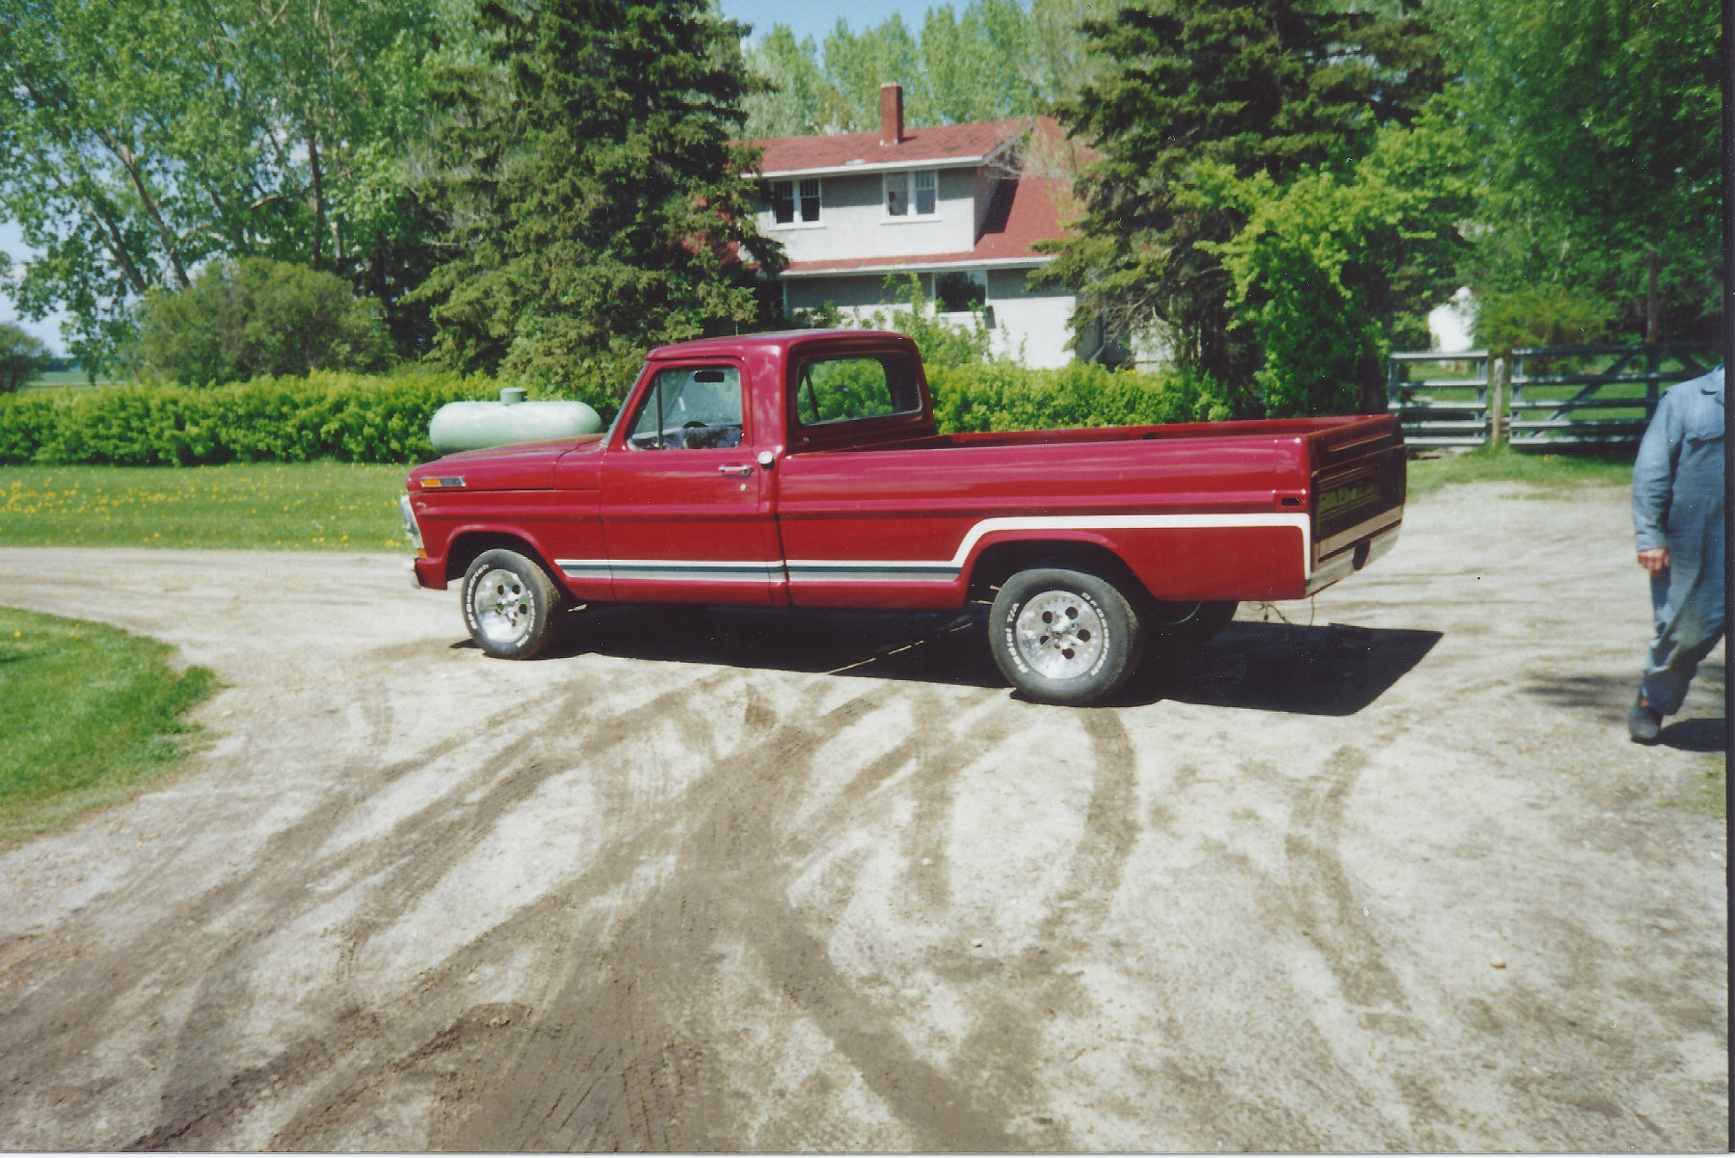
Rust Repair – Defect Elimination?
Notes:
Did not understand at the time. These repairs were eliminating a defect. The use of better materials, better metal coatings, and education regarding where rust was likely to occur were all a part of this process.

Slide 41
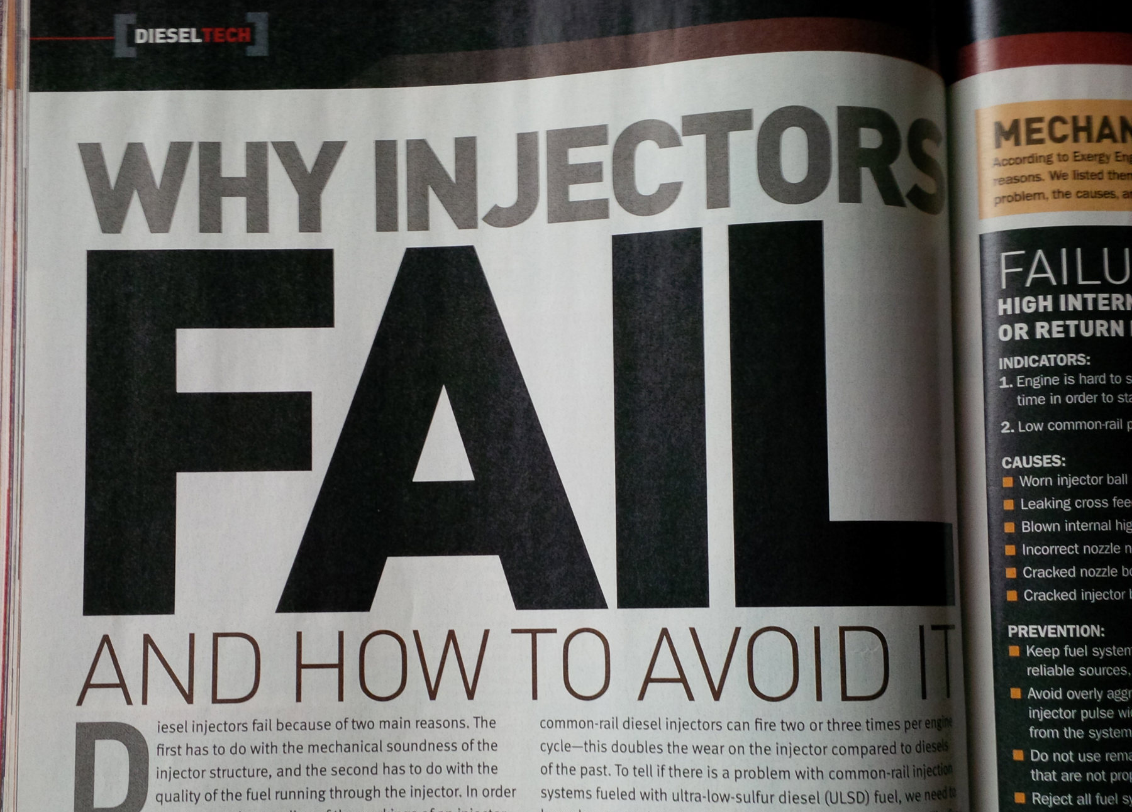
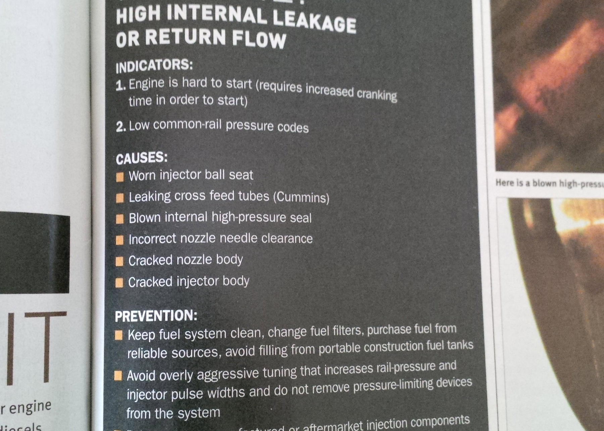
Asset Management is a
Defect Elimination Machine
Notes:
This concept appears in many places, but I have never had the feeling that someone sat me down 20 years ago and said. Norm your purpose is the eradication of failures, defects, etc. I wish they had. My outlook and focus might have been better targeted.
Process
People
Data
Equipment
Could expand to systems, thinking, decision making, and the list goes on.

Slide 42
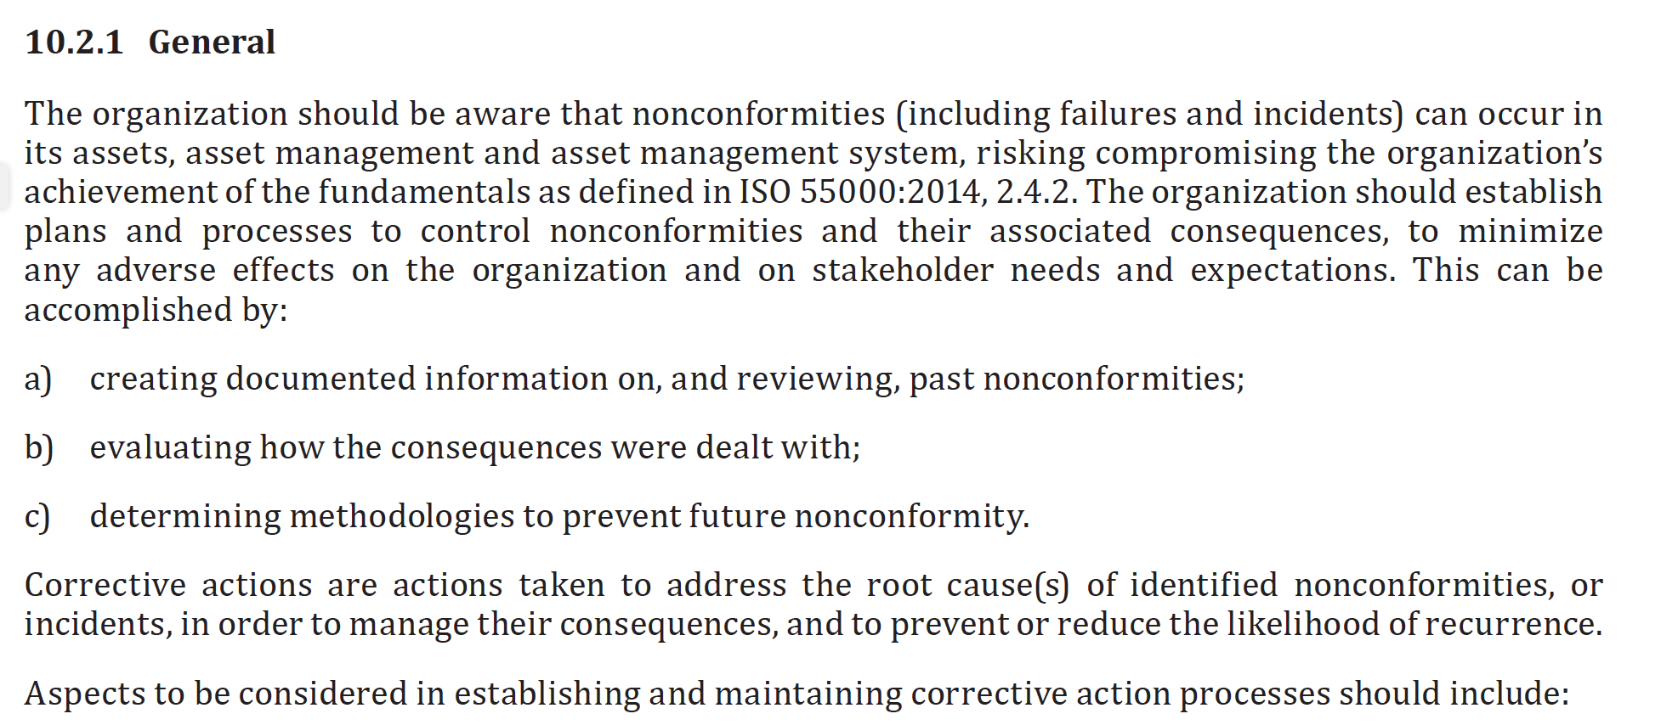
ISO 55000 Identifying Failures can occur in…
Notes:
Even the ISO standard considers the concept of failures in all of the categories I’ve been describing. Also, tossing in a new term nonconformity……

Slide 43
Backwards Bicycle

Slide 44
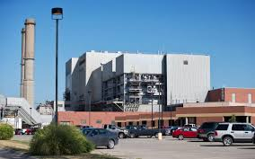
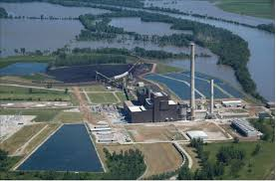
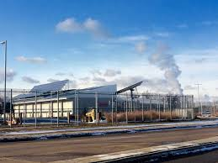
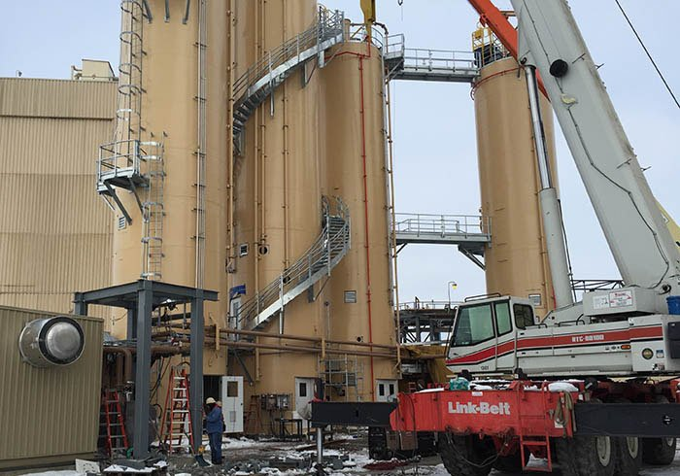
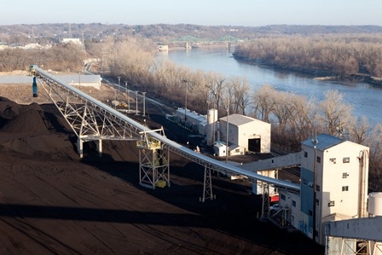
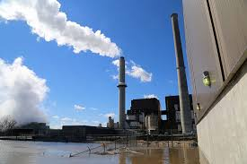
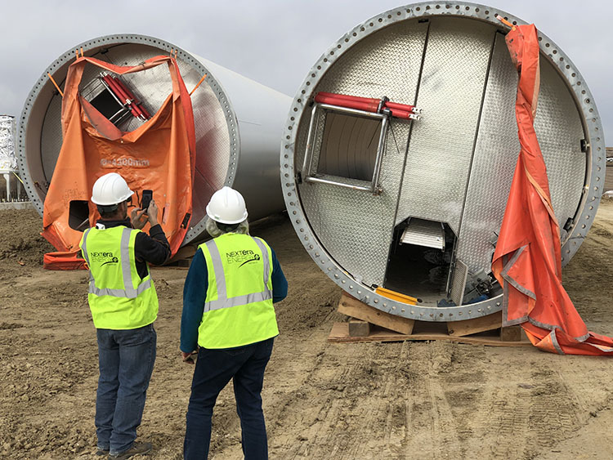
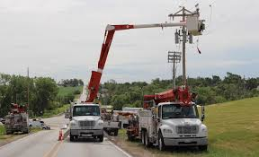

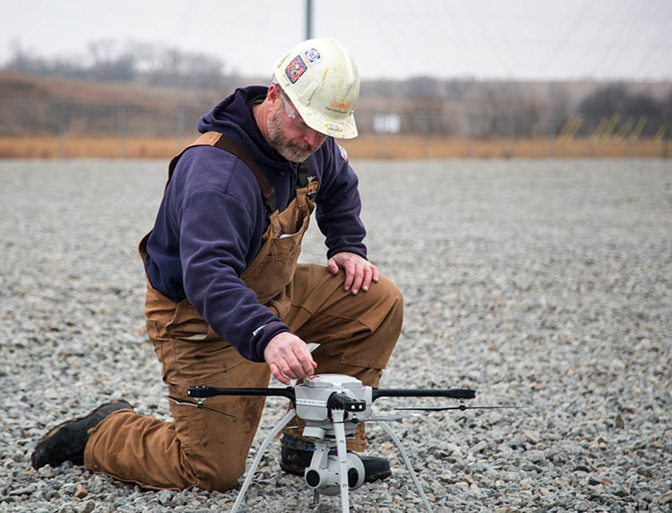


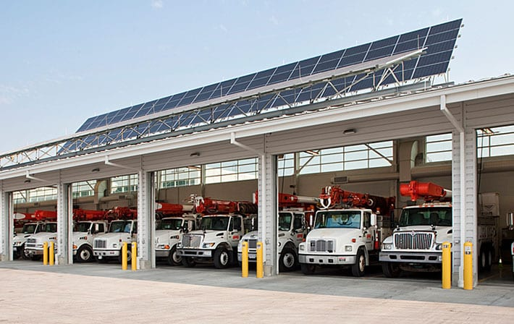
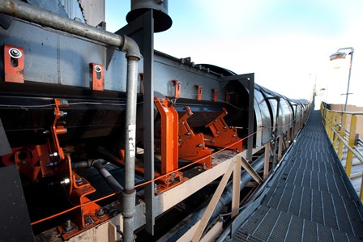
Favorite/Nemesis Equipment Discussion
What’s your favorite/nemesis equipment out in the
  Plant
  Field
  Facility
  Fleet

Slide 45
Exercise 2: Personal and Professional Why
Write down answers the following questions:
  What’s your personal “why” of Asset Management?
  What is your professional “why” of Asset Management?
WHY?
Notes:
Maybe combine the favorite equipment discussion with the why discussion?
Success here is if everyone sees the connection between managing assets and their passion.

Slide 46
Break: 10:50 – 11:00
"Only a genius can do things his own way.
You? You're no genius."
Unknown
Source: https://www.dudesolutions.com/blog/5-Quotes-for-Better-Facility-Maintenance

Slide 47
Exercise 3: Role Discussion
Considering the ”what” and ”why” of Asset Management:
  Round table discussion
    How does your role contribute to Asset Management
  Pick and scribe to capture the perspectives of each role
  Report back from the group

Slide 48
Lunch: 12:00 – 1:00
"The best way to predict the future is to invent it."
Alan Kay
Source: https://www.dudesolutions.com/blog/5-Quotes-for-Better-Facility-Maintenance

Slide 49
Exercise 4: Cross Disciplinary Groups of 4
Create your elevator pitch:
Describe asset management using any words you want to in a simple sentence(s). (make it a run on if you like grammar is not why we are here)
If you feel compelled make up a word like:
Assign a scribe
Report back to the group

Slide 50
Vocabulary of Asset Management
Vernacular
ISO55000 Terms
Clarity

Slide 51
OPPD vernacular
What does a standard mean to you?
  Minimum requirements?
What language would you expect in a standard?
  Shall?
  Must?
  Should?
How are quality expectations defined?
Notes:
Might want to expand on this to policy, procedure and provide time to discuss briefly.

Slide 52
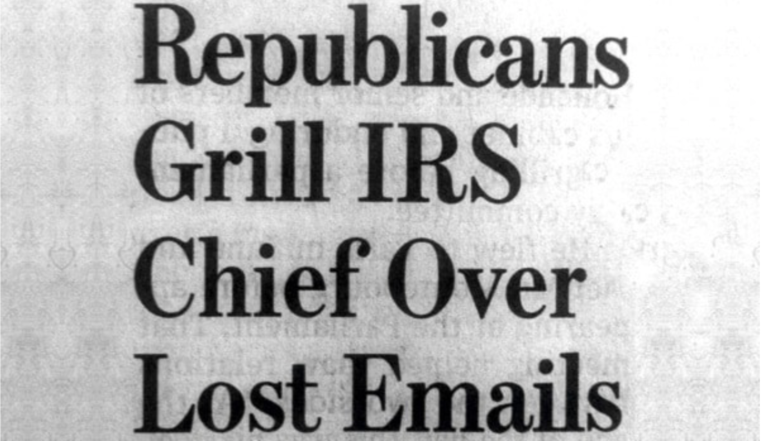
I came across this headline in the Wall Street Journal:
Republicans Grill IRS Chief Over Lost Emails
This type of sentence has great possibilities because of its two different interpretations:
  Republicans harshly question the chief about the emails
  Republicans cook the chief using email as the fuel
https://www.byrdseed.com/ambiguous-sentences/

Slide 53
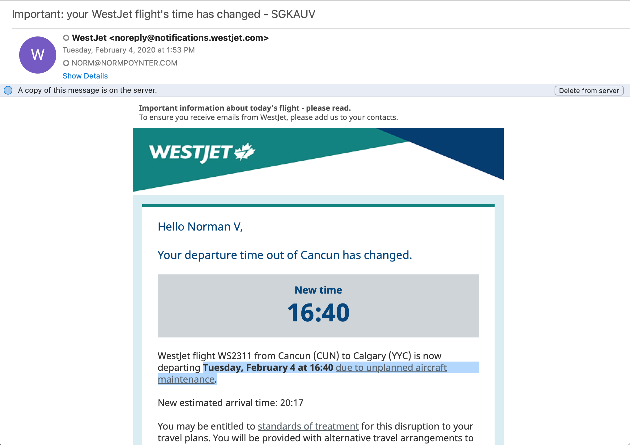
Tuesday, February 4 at 16:40 due to unplanned aircraft maintenance.

Slide 54
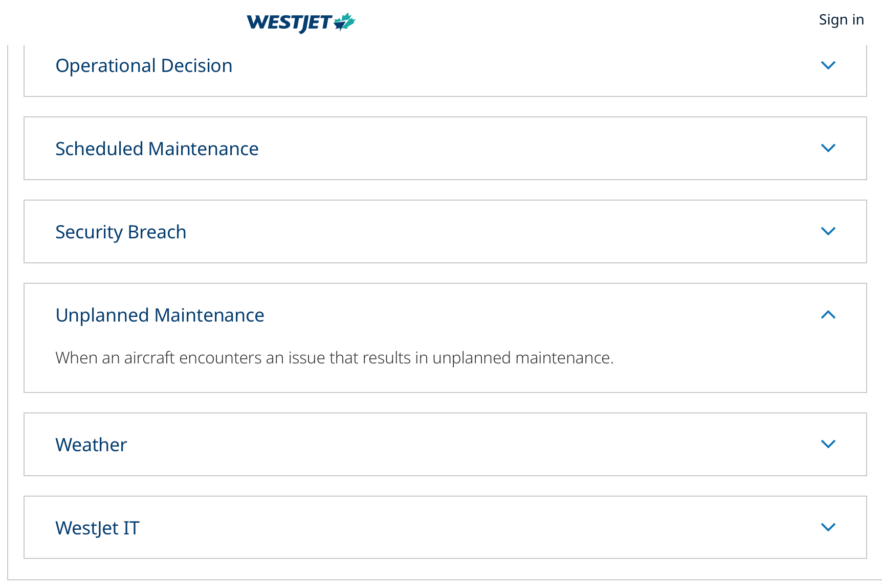

Slide 55
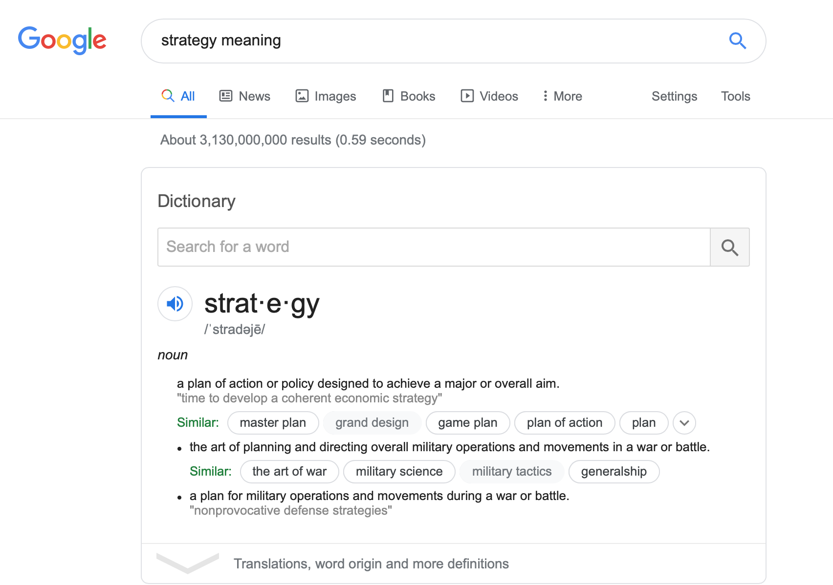
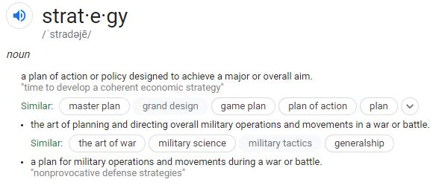
Specifics – “Strategy”

Slide 56
Google’s Strategy
Why I don’t get that meaning
  The word plan is part of the definition
  Too vague
  Doesn’t have any authoritative words which bite

Slide 57
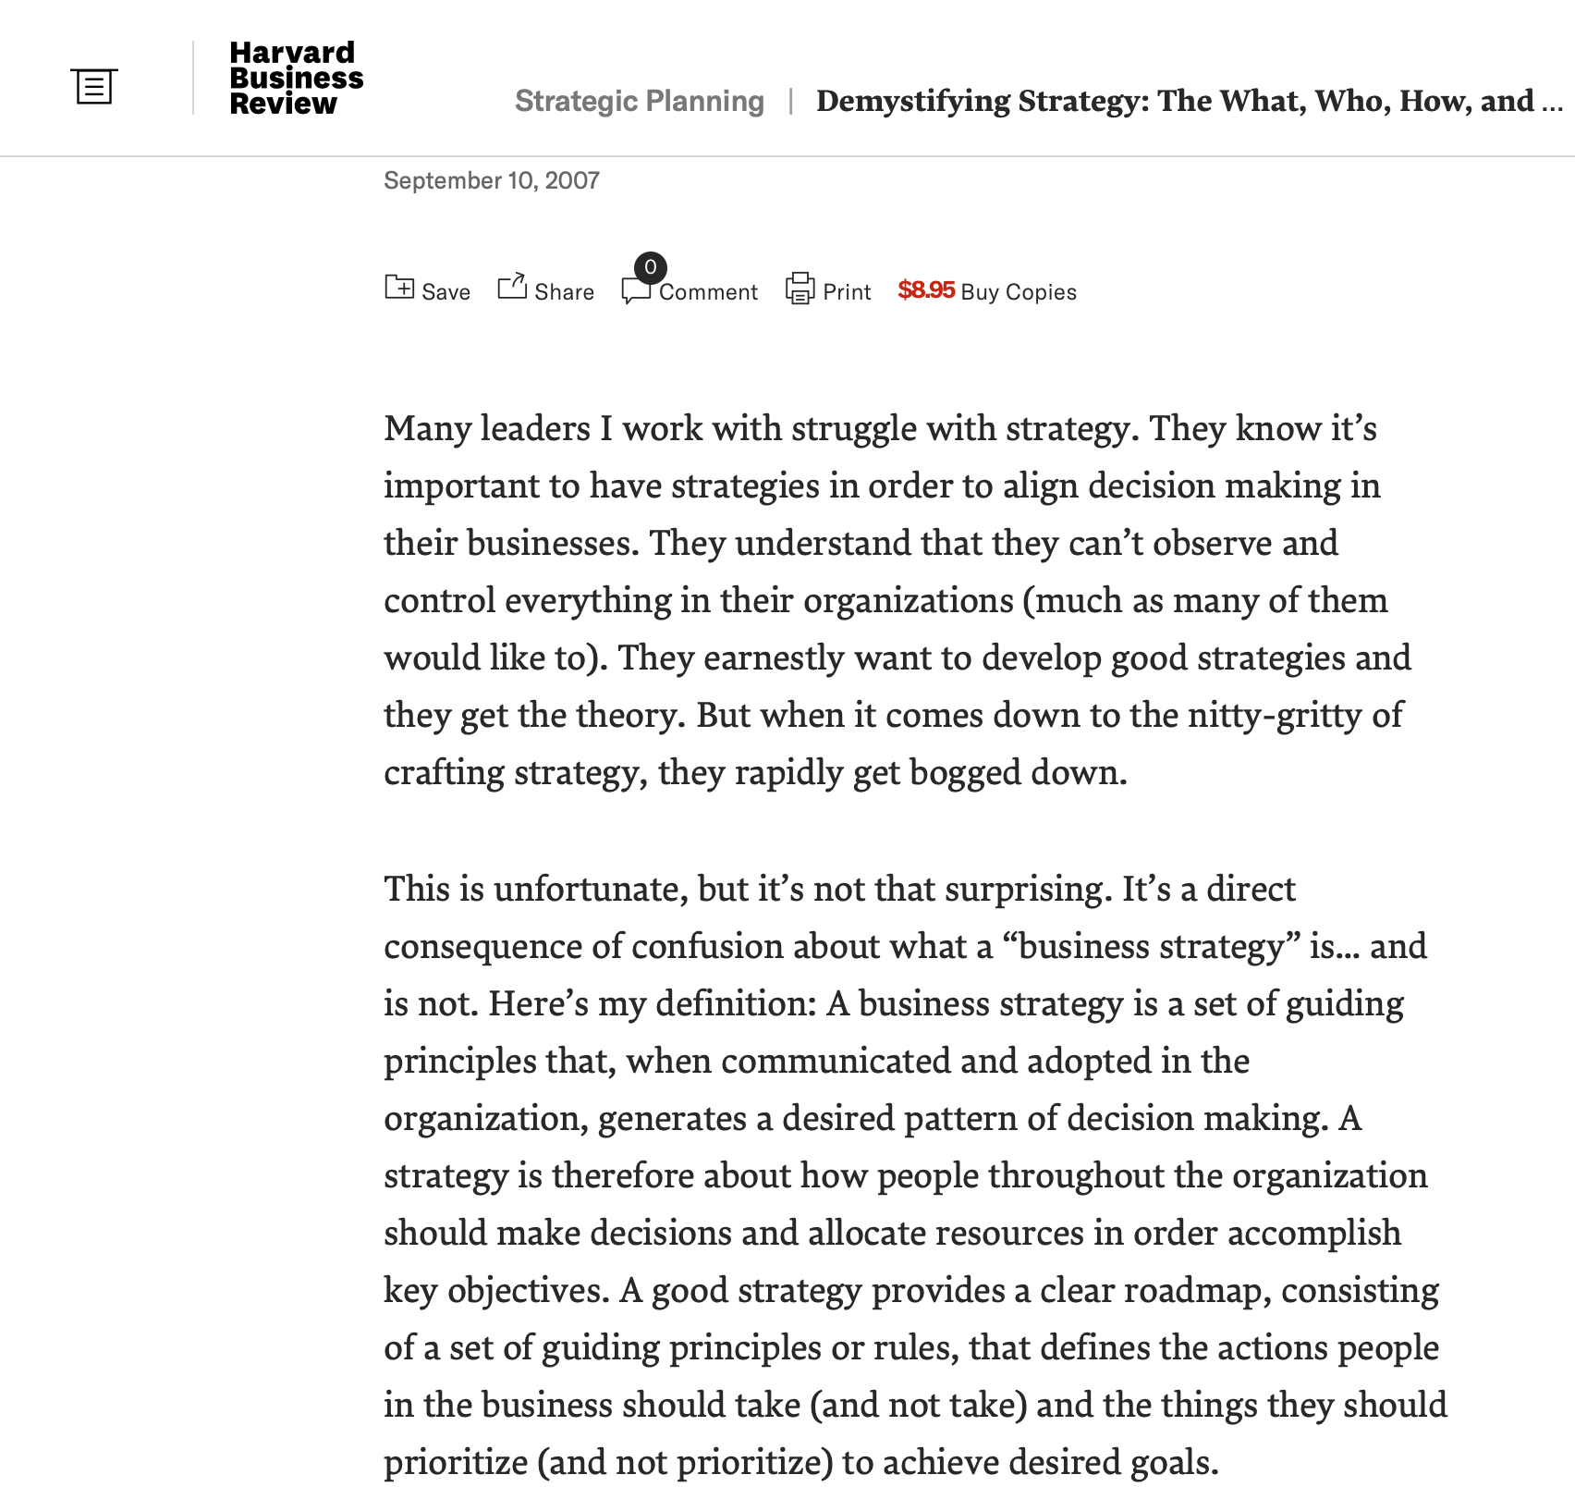
https://hbr.org/2007/09/demystifying-strategy-the-what
Notes:
A strategy is a set of guiding principles that, when communicated and adopted in the organization, generates a desired pattern of decision making, activity, deliverables through the allocation of resources in order to accomplish the key objectives of the organization.

Slide 58
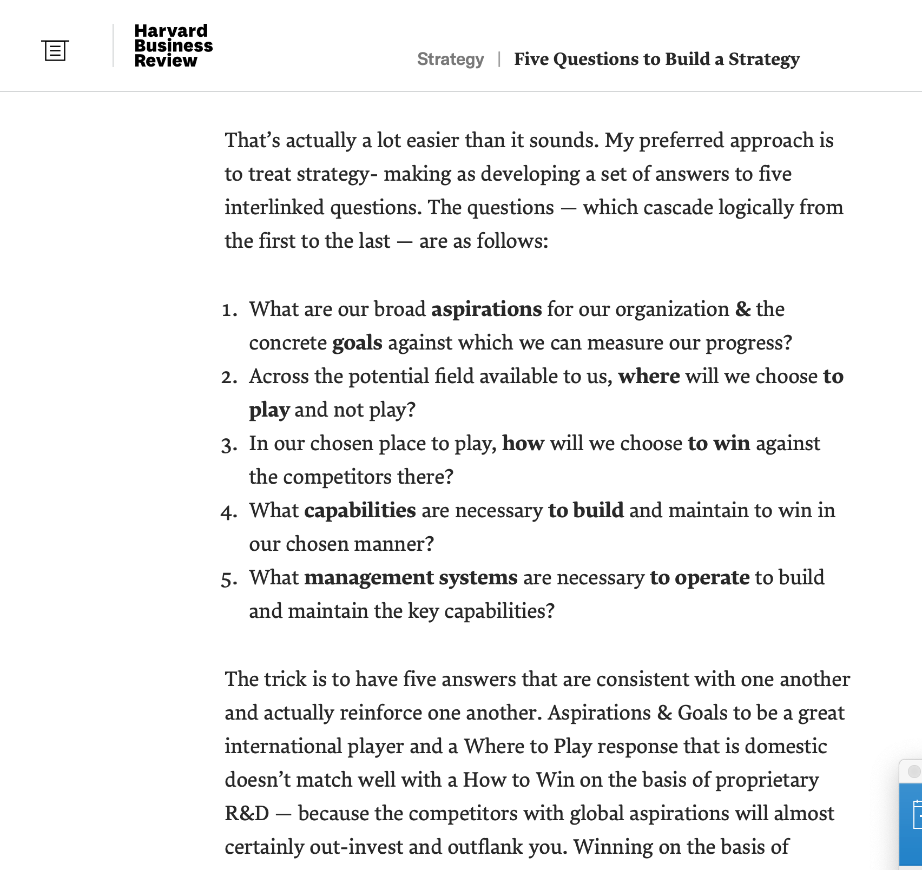
https://hbr.org/2010/05/the-five-questions-of-strategy?referral=03759&cm_vc=rr_item_page.bottom

Slide 59
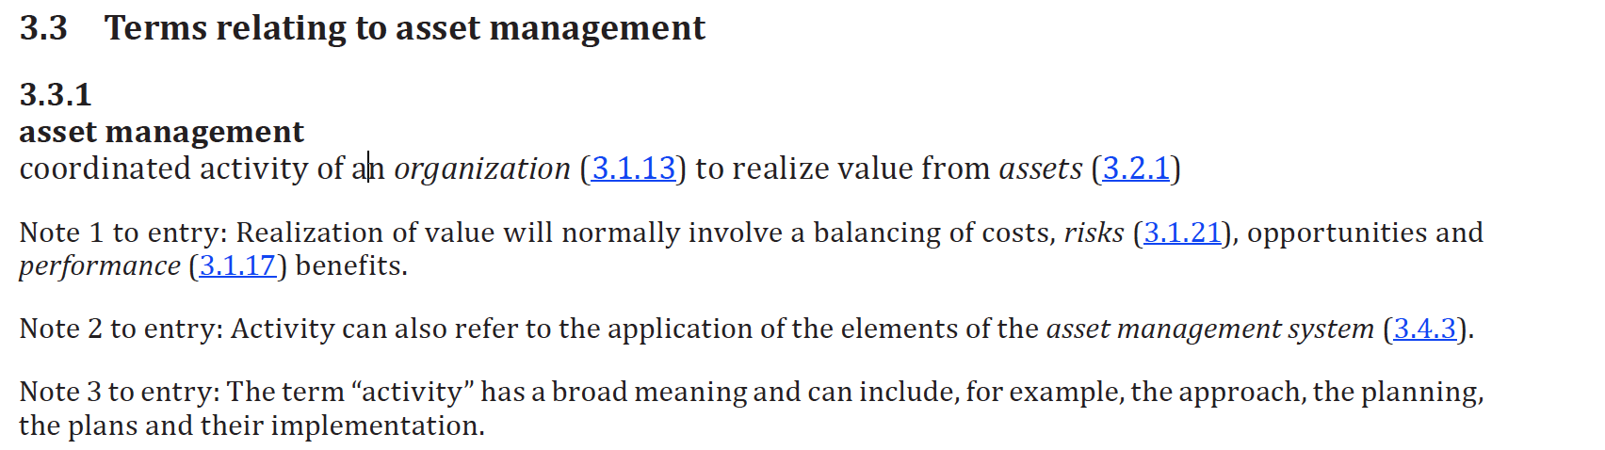
ISO 55000 – Terms Section
Source ISO 55000 – Terms Section

Slide 60
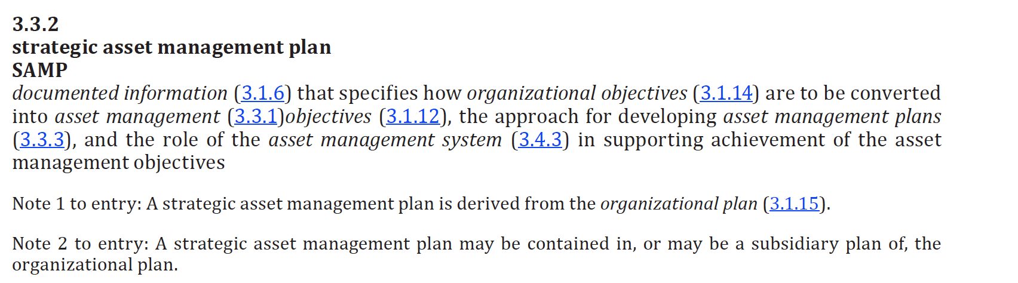
ISO 55000 – Terms Section
Source ISO 55000 – Terms Section

Slide 61
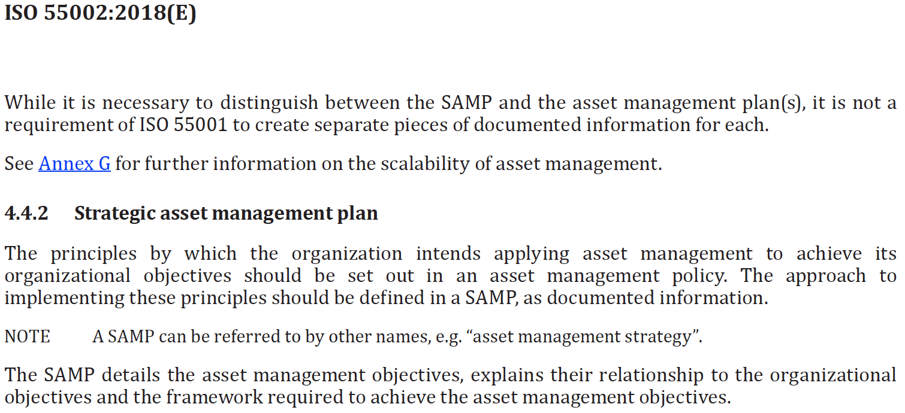
ISO 55001 – Requirements Section
Source ISO 55000 – Terms Section

Slide 62
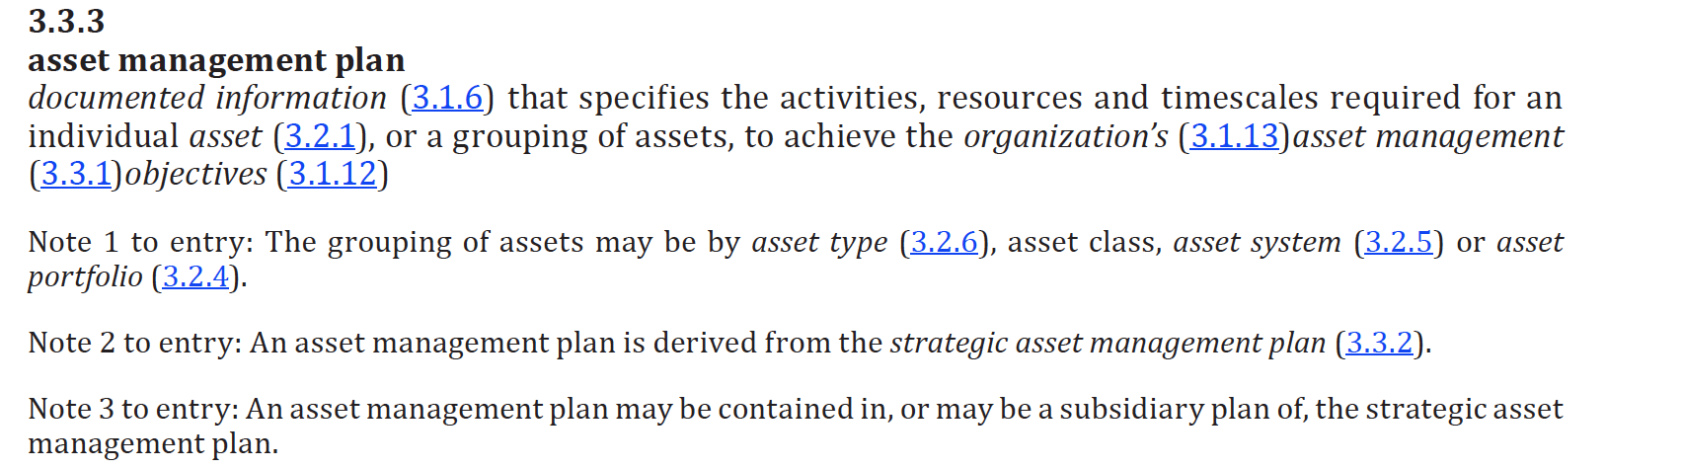
ISO 55000 – Terms Section
Source ISO 55000 – Terms Section

Slide 63
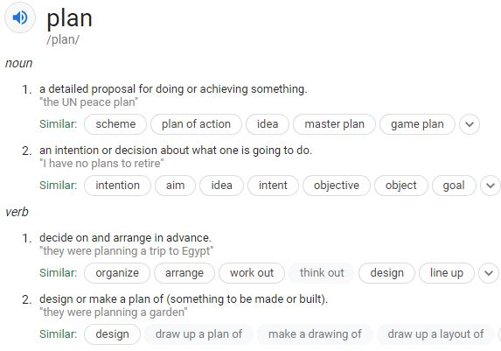
The term “Plan”
In general conversation
the term plan means:
In our context though it needs deeper details:
As a verb plan means
Scope, Estimate, Measurement document, cost, identify risks, determine contingency, etc.
As a noun it over arches a deliverable from above.

Slide 64
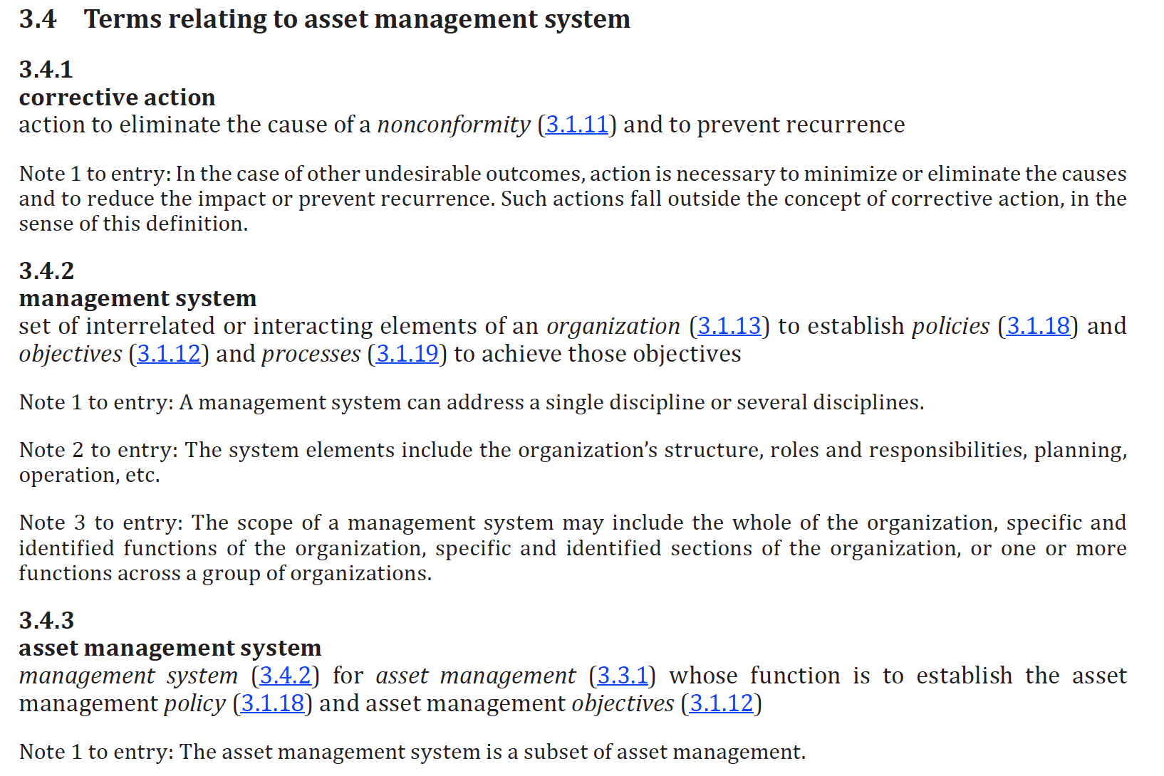
ISO 55000 – Terms Section
Source ISO 55000 – Terms Section

Slide 65
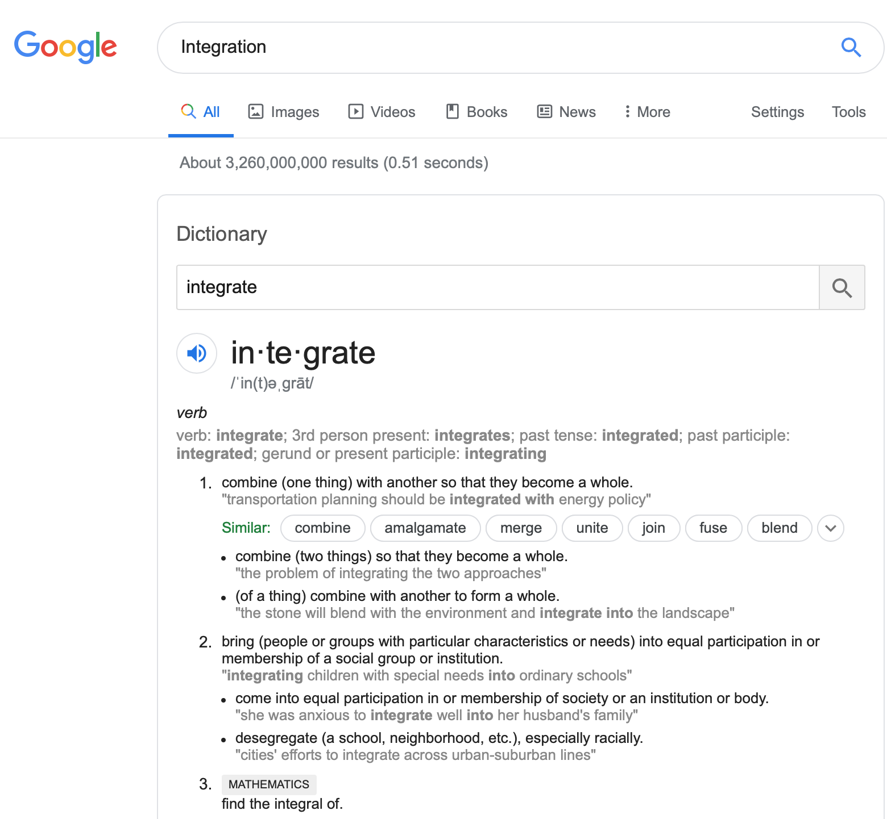
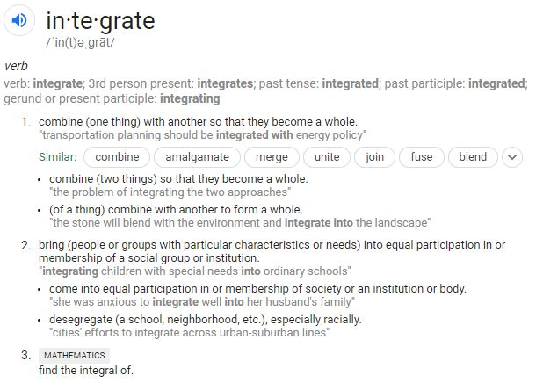
The term “Integration”

Slide 66
Break: 2:00 – 2:10

Slide 67
Integration of Management Systems
What is a Management System at OPPD
What is Integration of management systems
Scope

Slide 68

What is a Management System - Wikipedia

Slide 69
What is an existing Management System at OPPD?
Discussion:
  Put the statement “Management System” into
  OPPD Context
Notes:
Might want to expand on this to policy, procedure and provide time to discuss briefly.

Slide 70

ISO Management System Definition
Source ISO 55002 Introduction Section Page vii
Notes:
Not sure this slide is necessary either

Slide 71

Integration of Management Systems
Source ISO 55000 section 2.6 page 9

Slide 72

Integration “Scope”
Source ISO 55001 section 4.3 Determining the Scope of the asset management system page 1

Slide 73
Break: 2:50 – 3:00

Slide 74
Paradigms (beliefs) form the Vision
Vision shapes the Policies (Structures)
Structures drive behaviors (processes/standards/procedure)
Behavior yield results.
The collection of behaviors in an organization forms the culture.
If the desire is a different culture the behaviors must change.
If different behaviors are required, the structures (policies, processes, standards, procedures) must reflect the need.
However, most likely current vision and paradigms must be challenged first!
Corporate Business Strategy
Asset Management Strategy
Asset Management Scope
Notes:
Paradigms (beliefs) form the Vision. Vision shape the Policies (Structures) … Structures drive behaviors (processes/standards) … Behaviors yield results. The collection of behaviors in an organization form it’s culture. If want different culture … must change behaviors … if want different behaviors must change structures (policies) …. If want different structures (policies) must change current vision and challenge current paradigms (beliefs).

Slide 75
Inspiring a Change in Behavior
Results
“Culture”
Behaviours
People, Organization,
Individual
Systems, Process, Technology
Structures
Beliefs (Paradigms)
© Project Plato Inc.
Notes:
Consider audience participation/exercise (similar to having everybody spin around and point North).
Everyone will be pointing in different direction … This will lead into the perspective (beliefs/paradigms) slide illustrating different roles with different perspectives …
Which in turn leads into discussion that having everyone heading same direction is key.

Slide 76





Are we running on budget? I need to know where we are in our spend.
Why are we so far behind schedule, again?
Perspective
Manager
CEO
Why do I need to capture THAT part number?
I just ran a report on this department and only one third of the records contain data.
I don’t care what you need to do or what data you choose to capture … just keep the equipment running so I can do my job!!!
Maintenance Tech
Reporting Analyst
Operator
Notes:
Introduce Nexen example – safety re reliability and the number of people staffed in those organizations. They claim “reliability” is key but have many more staff in ‘safety’ area and place much more emphasis on safety.
Introduce misalignment of perspectives/behaviors between what we ‘say’ is important and our actual ‘behaviors/actions’.
For example, In our day-to-day lives we ‘say’ health and fitness is most important thing, yet most of us choose unhealthy behaviors (poor diet, lack of exercise).
Disparate perspectives
Norm to adlib - maximum two minutes.
Note: no-one is necessarily wrong in their thinking – just different. Challenge is: How get people to “adjust” slightly, compromise and find the common direction.

Slide 77
Perspective Requires A Common Thread
The common thread needed to unite the disparate perspectives of these different roles is a universal VISION
For example, the vision may be “Leading the way we power the future.”
But in my experience vision alone is not enough…
Notes:
To avoid the waste and frustration that accompanies a work environment (project) that has different perspectives – must unite these different perspectives. To unite the perspectives must have common vision (eg hockey team; football team).
Describe and define a common thread in our lives to tie together. For example … Starbucks – if didn’t have common vision couldn’t get same cup of coffee at different service locations. Doesn’t matter which location people go to, they expect things in a certain way.
Come up with three or four vision statements from different perspectives (avatars) eg Manufacturing – “We will build the best widget”; Oil & Gas – “We will be the most environmentally sustainable producer.”; Utility – We will provide the most reliable service“
Relate those back to the common thread

Slide 78
What is a Vision?
We need agreement that we’re going to work collaboratively to improve this area.
Vision
We need to write it down, so we have certainty and clarity around it.
CEO
Manager
Vision
Notes:
Come full circle from first slide – from tactical perspective to acknowledging common thread … to CEO making vision-type statement. Is your vision really part of day-to-day thinking? How have you started constructing your tasks to support?

Slide 79
Everything must be running along smoothly now that we have a common vision.
I’ve sent spreadsheets showing where data is missing.
CEO
Reporting Analyst
What’s with all the spreadsheets the reporting analyst is sending me? I don’t have time to read all this. I have a business to run.
Where’s the rule that says we need to collect all this data and run all these reports? Clearly we still have some outstanding issues.
Manager
Is my machine fixed yet? What’s the hold up?
Maintenance Tech
Operator
Notes:
Now you think you’ve got a vision …. But it’s not enough. Just because you’ve crafted and agreed on a common vision doesn’t mean that behaviors will change. What does it take to change behaviors?

Slide 80
Boss, we need more than just saying ‘data is important’. We need some written rules and clarity around this.
Manager
I agree. Let’s formalize this and call it our Asset Management Policy.
CEO
Vision
Policy
+
Notes:
Manager/CEO conversation …
This is where we introduce the next level or the remainder of the pyramid – i.e. the first level “Vision” is not enough … need all the other foundational elements.
First key message goes from perspective; to common thread … to need to go deeper because Vision has not changed peoples behaviors. You can everyone aligned and in agreement but so what …

Slide 81
Key Message
“Vision” alone does not change people’s behavior.
Notes:
In order to change behavior need a solid structure (foundation) containing full suite of intellectual capital – written policies; documented business processes, standards and procedures.

Slide 82
Fun Theory Speed Camera Lotto - Video

Slide 83
What is a Policy?
Vision
What is a Policy?
  A policy is an organizational level rule intended to
  govern behaviors and actions
  Policies typically contain high-level statements
A Written Policy is the first tangible deliverable
Be careful with Policy though – be very clear on why you are writing it
Too many polices - they become lost and almost meaningless
Policy
Notes:
Perhaps introduce concept that corporate structures are driven by beliefs and paradigms, which in turn shape behaviors. Generally, structures are either people-based or systems-based.
Organizations use 'policies' to express their corporate beliefs and paradigms and to govern behaviors. For example, most organizations have a number of environment, health and safely policies. Corporate policies are typically governed by management systems, Key Performance Indicators (KPI's), audits, and more.
Discuss personal biggest frustration is organization’s rarely take the time to physically capture structural element – i.e. actually PRINT a policy, hang it on the wall and ILLUSTRATE how it links back to SAP.
What does ‘reliability’ have?

Slide 84
We’ve got our vision and policy … but we seem to be spinning our wheels. We’re not making as much progress as anticipated. What’s missing?
We need a common business process to manage our assets
CEO
Manager
Vision
+
Policy
+
Process

Slide 85
What is a Process?
What is a (Business) Process?
  A (business) process identifies ‘what’ happens over time (i.e. first this happens, then that happens, …)
Vision
Policy
Process
Notes:
Emphasize - It’s not the ‘how’ it’s the ‘WHAT’.

Slide 86
We’ve got our vision, our policy and our business process … but everyone seems to be doing their own thing. We call it a widget; operators call a gadget and the reporting guys call it an object. This is confusing and we argue a lot.
We need to standardize.
Manager
CEO
Vision
+
Policy
+
Process
+
Standard

Slide 87
What is a Standard?
What is a Standard?
  A Standard is a document which sets out the requirements (i.e. the things you must have and must do … and the quality expectations)
Vision
Policy
Process
Standard

Slide 88
We’ve got our vision, policy, business process and standard … I can’t wait to see the progress now!
I’m all for Asset Management, but I looked at the numbers. At this rate, it’ll take us 10 years to complete the date entry let alone make decisions. We’re effective but we need to be more efficient.
CEO
We want to complete the work, but we all enter it differently. We need procedures to help everyone.
Manager
Asset Champion
Vision
+
Policy
+
Process
+
Standard
+
Procedure

Slide 89
What is a Procedure?
Vision
What is a Procedure?
  A Procedure is a tool (document or other media) which provides step-by-step instructions explaining ‘how’ to perform the tasks identified in the process and to meet the requirements of the Standard.
Policy
Process
Standard
Procedure
© Cornerstone Communications

Slide 90
Key Message
To support Vision you need documented policies, business processes, standards, and procedures
  Note: key word ‘documented’ – Correlates to ISO55K expectations
Will not experience success (behavior change) without all the structural blocks
Vision
+
Policy
+
Process
+
Standard
+
Procedure
=
Behavior Change
Notes:
Need focused effort to produce physical, tangible document
Need commitment, discipline, and follow-through
(consider inserting ADD example)
The importance of a structured approach?
The behavioral triangle? (Does it have a name?)
What about audit? Measurement where should it go in this discussion?

Slide 91
Structural Blocks
Step 1 Corporate Business Strategy
Management System Starts Here:
Step 2 Corporate Policies
  Asset Management Policy inclusive in Corporate Policy(s)
    Contains a statement like – “A critical asset shall have a correlating Inspection Testing Preventive Maintenance Task” or “OPPD Assets shall have lifecycle costing practices applied.”
Or Management System Starts Here:
Step 3 Asset Management Strategy (SAMP) references / contains
  Organization context
    Asset Management Objectives integrated to organizational objectives
  Stakeholder requirements
    Scope of the Asset Management System (Improvement tasks, Steady state tasks)
  Asset Management Scope (*Plans)
    Maintenance Significant / Criticality Assessment Results
    Identification of Failure modes
    Mitigation of Failure modes through development or identification of Inspection Testing Preventive Maintenance Tasks
    Frequency of Inspection Testing Preventive Maintenance
    Scope of Inspection Testing Preventive Maintenance
Step 4 Quantitative metric defined to measure the policy statement
    100% of Critical Assets have a corresponding inspection task scheduled in the CMMS
Step 5 Qualitative metric defined to measure the policy statement
  90% of critical assets passed the inspection criteria when the inspection is performed per the asset strategy frequency

Slide 92
Exercise 5: Create a Management System
Write a simple:
  Vision
  Corporate Strategy by answering the 5 questions
  Asset Management Policy – single statement
  Asset Management Strategy
  Asset Management Scope
  Create a short Asset Management Process (5 steps)
  Create an Asset Management standard for one of the process steps
  Create a short Asset Management procedure to achieve the desired outcome
Bakery (Group 1)
Coffee Vendor (Group 2)
Mouse Trap Manufacturer (Group 3)
Gas Station Franchise Owner (Group 4)

Slide 93
Day 1 Learning Intention and Objective Review
Setting context
Challenge your thinking
Building the foundation and applying fundamentals

Slide 94
End of Day 1

Slide 95
Asset Management Overview
Omaha Public Power District

Slide 96
Day 2
Safety Briefing

Slide 97
Agenda – Day Two (Morning)

Slide 98
Agenda – Day Two (Afternoon)

Slide 99
Day 2 Learning Intention and Objective
Creating Line-of-Sight
Putting theory into practice
Collaboration
Notes:
Do we agree with these?

Slide 100
Review and Reflect
What were 3 key messages you took away from yesterday?
  They could be from the slide deck
  Discussion
  Or even your own deductions or epiphanies

Slide 101
What is OPPD’s Why?
Aside from what Javier said to kick us off yesterday

Slide 102
Burn-E Video
https://www.amazon.com/gp/video/detail/B00APN5RYQ/ref=atv_dl_rdr?autoplay=1

Slide 103

Theories of Asset Management
Notes:
This is an awkward section given how I’ve titled it. The theories aren’t real if that makes sense. There is so much stuff or fluff floating around about this when it really boils down to a clear line of sight for everyone. I think most of the material we are accessing is overly verbose when it comes to this topic. And if we work backwards based on objectives then the verboseness is unnecessary.
Maybe though the verboseness acts as a reminder to what is necessary?
There are so many diagrams available to describe the theory of asset management that it is very hard to choose just one. I’m not a big fan of such diagrams, because at the end of the day its still about understanding, purpose, passion, direction and lines of sight. Therefore for this section we are going to focus on lines of sight. In hindsight I would have probably titled this section just that – Asset Management Lines of Sight.

Slide 104

Concepts and Principals – but based on four fundamentals?????
2.3 Concepts & Principles
Clause 2.4.2 of ISO 55000 states that asset management is based on four fundamental: Value, Alignment, Leadership and Assurance. In addition to these, two features of asset management, which differentiate it from other disciplines and management systems, are its focus across the whole asset life cycle and its approach to decision making.

Slide 105


Slide 106
Break: 9:10 – 9:20

Slide 107

Its always about the line of sight….
2.3.2 Alignment (or “Line of Sight”)
Good asset management has clear connectivity between and organization’s strategic plan (commonly called the business or corporate plan) and the asset management activities delivered by staff. This is known as alignment, or ‘line of sight’ and enables everybody to understand how they contribute to achieving success.

Slide 108

ISO 55001 Section 7.5 – Without Asset Information Asset Management is not possible.

Slide 109
Let’s Consider Maps
The History of Cartography
Cartography or mapmaking, has been an integral part of the human history for a long time, possibly up to 8,000 years. [1] From cave paintings to ancient maps of Babylon, Greece, and Asia, through the Age of Exploration, and on into the 21st century, people have created and used maps as essential tools to help them define, explain, and navigate their way through the world.
Maps began as two-dimensional drawings but can also adopt three-dimensional shapes (globes, models) and be stored in purely numerical forms.
The term cartography is modern, loaned into English from French cartographie in the 1840s, based on Middle Latin carta "map".
https://en.wikipedia.org/wiki/History_of_cartography

Slide 110
What maps do we have?
Probably known as “drawings”
  P&ID Piping and Instrumentation
  Vendor Detail Drawings
  General Arrangement
  Single Line Drawings
  Process Flow Diagrams
  Etc.
Where do you start gathering your asset information?
How are you defining Asset Information?

Slide 111

Common P&ID Problems - Generic or Typical Cookie Cutter Designs

Slide 112
A Simple Database
Cust_ID | CustName
1 | John
2 | George
3 | Mary
4 | Jane
5 | Sarah
Movie_ID | Movie_Title
1 | Scooby - Do
2 | Star Wars
3 | Smokey & The Bandit
4 | The Expendables
5 | Witness
6 | Red Dawn
7 | Arthur Christmas
8 | The Amazing Spiderman
9 | Total Recall
Rental_ID | Cust_ID | Movie_ID
1 | 5 | 7
2 | 4 | 1
3 | 4 | 5
4 | 1 | 2
5 | 3 | 8
6 | 2 | 8
7 | 2 | 9
8 | 5 | 1
9 | 1 | 6

Slide 113

Your Home is a Plant & Has Asset Management Needs Too!
Temperature and Pressure Relief Valve
  Drawing or schematic
  Service Interval
  Recommended Pressures and setting
  Spare Parts
  Overflow Capacity
  Operating Procedure
Control Valve
  Drawing or schematic
  Spare Parts
  Operating Procedure
  Test Procedure
  Troubleshooting Guide
Gas/Electrical Supply
  Wiring Diagram
  Gas and Electrical supply requirements
  Test Procedure
  Commissioning Procedure
Notes:
Once we understand that information surrounds us we can begin to align the importance of this information with our everyday lives.
A hot water in your house is a simple example of a pressure vessel.
The interesting and I hope thought provoking element is the risk associated with a simple hot water tank

Slide 114
Risk Associated With Your “Plant”
Event | Result | Consequence
Explosion | No injury | Property
Explosion | Injury | Property & People
Leak | No injury | Property
Loss of Production | No injury | COLD SHOWER!

Slide 115
Myth Busters

Slide 116
Managing risk requires:
Transparency of information
Quality of information
Association of disparate information
Notes:
Discuss the Layers of Protection Concept and introduce Independent Layers of Protection (IPL’s)

Slide 117
Independent Protection Layer (IPL)
Hazards
Out of date standard operating procedures
Inaccurate Set points
Accident
Missing name
plate data
Notes:
Animation will allow for the labeling of the holes and as they appear on the slide the speaking notes will speak to each one.
i.e. master data, duplicate tags, inconsistent conventions etc until the middle one appears and the line goes through.

Slide 118
Layers of Protection Analysis (LOPA)
Design Inadequacies
Hazards
Information Gaps
Disregard for Safety
Weak Management
Systems
Organizational
Factors
ACCIDENT
Equipment
Failure
Human
Error

Slide 119
Layers of Information Protection Analysis (LOIPA)
Insufficient Standards
Incomplete O&M Data
Information Volumes
Disparate Systems
Weak Document Management
Non-Integrated MOC processes
Missing or Lost Information
Complex Technology
Insufficient Information Management competencies

Slide 120
Break: 10:10 – 10:15

Slide 121
Exercise 6: Water Tank Replacement
Everyone has a hot water source of some kind. Most have experienced some sort of issue, incident, failure at one time or another.
This exercise brings home the need for Asset Management and provides a mechanism to test thinking, vision, policy, process, standard and procedure.
Using the handout come to a decision regarding the scenario you’ve been assigned.
  Answer the questions in the handout
  Capture your assumptions
  How does asset management principles play into your decision

Slide 122
Break: 11:05 – 11:15

Slide 123
Report Back on Asset Replacement Exercise
Scenarios follow on subsequent slides for reference

Slide 124
Scenario 1: New home not enough capacity (Group 1)
You and your family have just purchased a brand-new home and the hot water tank does not provide enough capacity for 2 adults, and 2 teenagers. The current tank is a 40-gallon electric unit with seemingly no advanced internet of things (IOT) technology. The basement of this new home is completely unfinished. And therefore, a blank canvas. The home is a 4-bedroom, 3.5 bath with a steam shower in the master.

Slide 125
Scenario 2: – Used home renovation in progress (Group 2)
Recently you moved your family back into your childhood home. Its, of course, dated and subsequently you’ve decided to do a major home renovation.
The house is about 45 years old and retains its original furnace and most infrastructure (electrical, plumbing, venting). The hot water tank appears to be less than 5 years old, is pilot light controlled, gas fired and has a 50-gallon capacity.
Preventive maintenance records have been recorded on a hanging tag off the pressure relief device and there is a logbook from a local contractor indicating servicing yearly dating back 5 years.

Slide 126
Scenario 3: – Tank failure (Group 3)
Upon returning from a short business trip, you find your hot water tank is passing hot water through the pressure relief valve. The drain in your floor is barely keeping up with the flow and you are at risk of flooding. The worst part is the burner is on constantly and it seems as though the temperature limit switch has failed as well.
There is no evidence of any preventive maintenance ever being performed on the unit, and no indication of the age of the unit.

Slide 127
Scenario 4: Environmental sustainability is highest priority (Group 4)
You are on a mission to make your home the most energy efficient it can be. To do so you are review all home systems for replacement or upgrade and the hot water tank is at the top of the list. Currently, everything is operating satisfactorily but within the next 3 months you want to have put together your strategy, scope/estimate and schedule for replacement.
In this scenario consider all aspects of your homes heating and cooling systems to determine the best asset decision.

Slide 128
Lunch: 11:45 – 12:30

Slide 129
Open Mic Your Context
Examples
Questions
Open Discussion
Your opportunity to ask how will this affect OPPD, Me, my peers, my reports…

Slide 130
Break: 1:20 – 1:30

Slide 131








Slide 132

Snakes & Ladders
Snakes and Ladders game is focused on the development of an asset management strategy
The purpose of the game is to help you explore the elements that contribute to the strategy
  Timing
  Prioritization
  Priorities
  Risks
  Opportunities

Slide 133
Snakes & Ladders
Ladders represent elements of strategy to establish, operate and maintain elements of the Asset Management System
Examples of Ladders
  Establishing an Asset Management team
  Developing an AM policy
  Setting AM objectives
  Establishing processes for AM plan development and use
  Identifying AM competencies and associated training requirements

Slide 134
Snakes & Ladders
Snakes are elements or actions that delay or derail AM implementation efforts
Example of Snakes (risks)
  Departure of key personnel responsible for AM initiatives
  Loss of focus and support of the leadership team (if improvements takes more time than anticipated
  Failure of the leadership team to demonstrate behaviors set out in the AM Policy
  Rewarding reactive behavior over reliability-oriented behavior

Slide 135
Day 2 Learning Intention and Objective Review
Creating Line-of-Sight
Putting theory into practice
Collaboration

Slide 136
End of Day 2

